Slide 1
Maker: Electronics
Gradient controller
Mike Twieg
Dept. of Radiology, Case Western Reserve University, Cleveland, OH, United States
June 18, 2018

Slide 2

Declaration of Financial Interests or Relationships
Speaker Name: Mike Twieg
I have the following financial interest or relationship to disclose with regard to the subject matter of this presentation:
Company Name: Siemens
Type of Relationship: Research Support

Slide 3
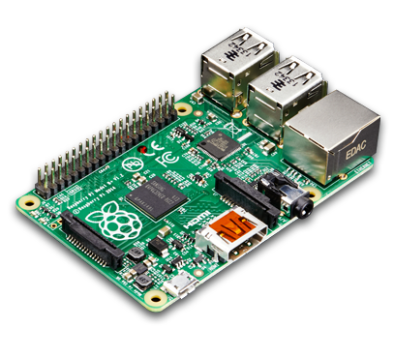
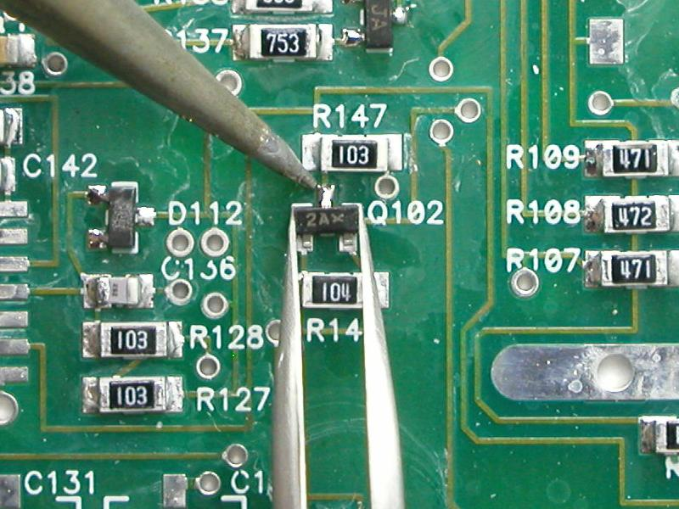


Objective
Construct a simple gradient amplifier
No embedded systems
No custom PCBs
Medium power (2kVA peak)
Scalable
Cover following concepts
Pulse width modulation (PWM)
High power safety and equipment
Control loop design
Notes:
45s
In this talk I’m going to walk you through the design of a simple gradient power amplifier and controller
To go along with the maker theme of this sunrise series, the design was tailored to be accessible to non-experts in power electronics
It primarily uses analog electronics
***So it doesn’t rely on embedded systems or software
***But it also won’t require any custom PCBs or difficult soldering
***The power level is modest, in order to
***keep things fairly safe
***And affordable
***But the fundamental concepts are scalable
***We’ll also be discussing important concepts such as
Pulse width modulation
high voltage safety
And feedback controller design

Slide 4
System overview
Control
u(t)
Error
e(t)
Reference
r(t)
Controller
PWM modulators
Power stage
Filter
Current sensor
Coil
Σ
+
-
Output
y(t)
Modern gradient amplifiers are switchmode
Pulse width modulation (fixed frequency)
Notes:
15s
Here is a basic block diagram of our system
Modern gradient amplifiers use switchmode circuits to achieve good power efficiency
***So let’s do a quick review of how pulse width modulation is used for power amplifiers
In particular, we’ll be using fixed frequency PWM

Slide 5
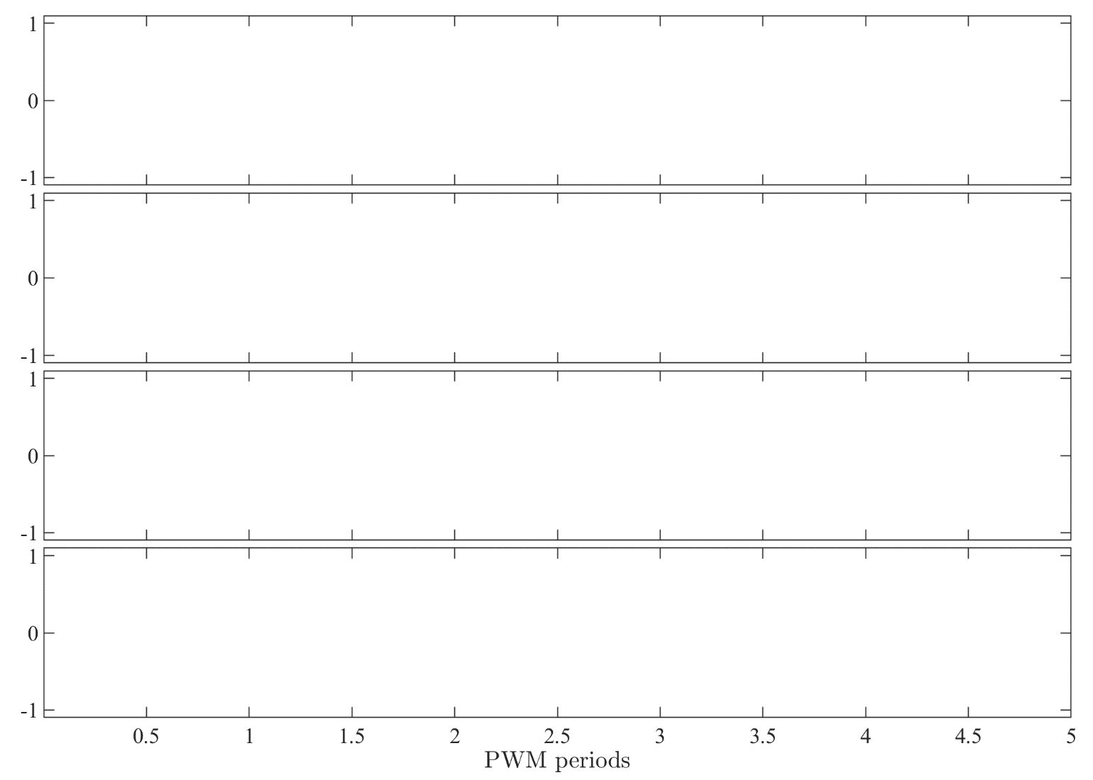
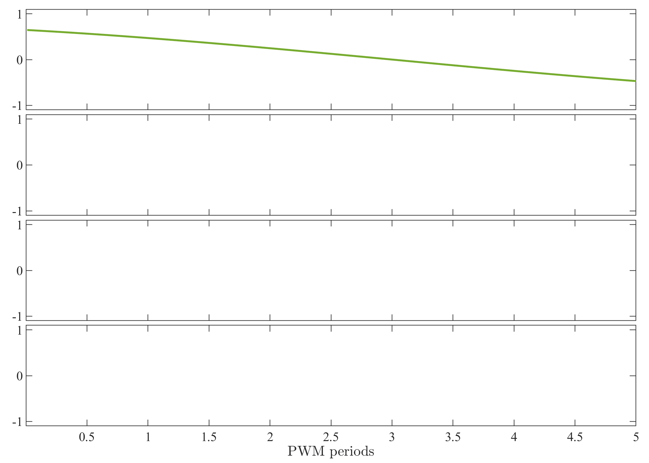
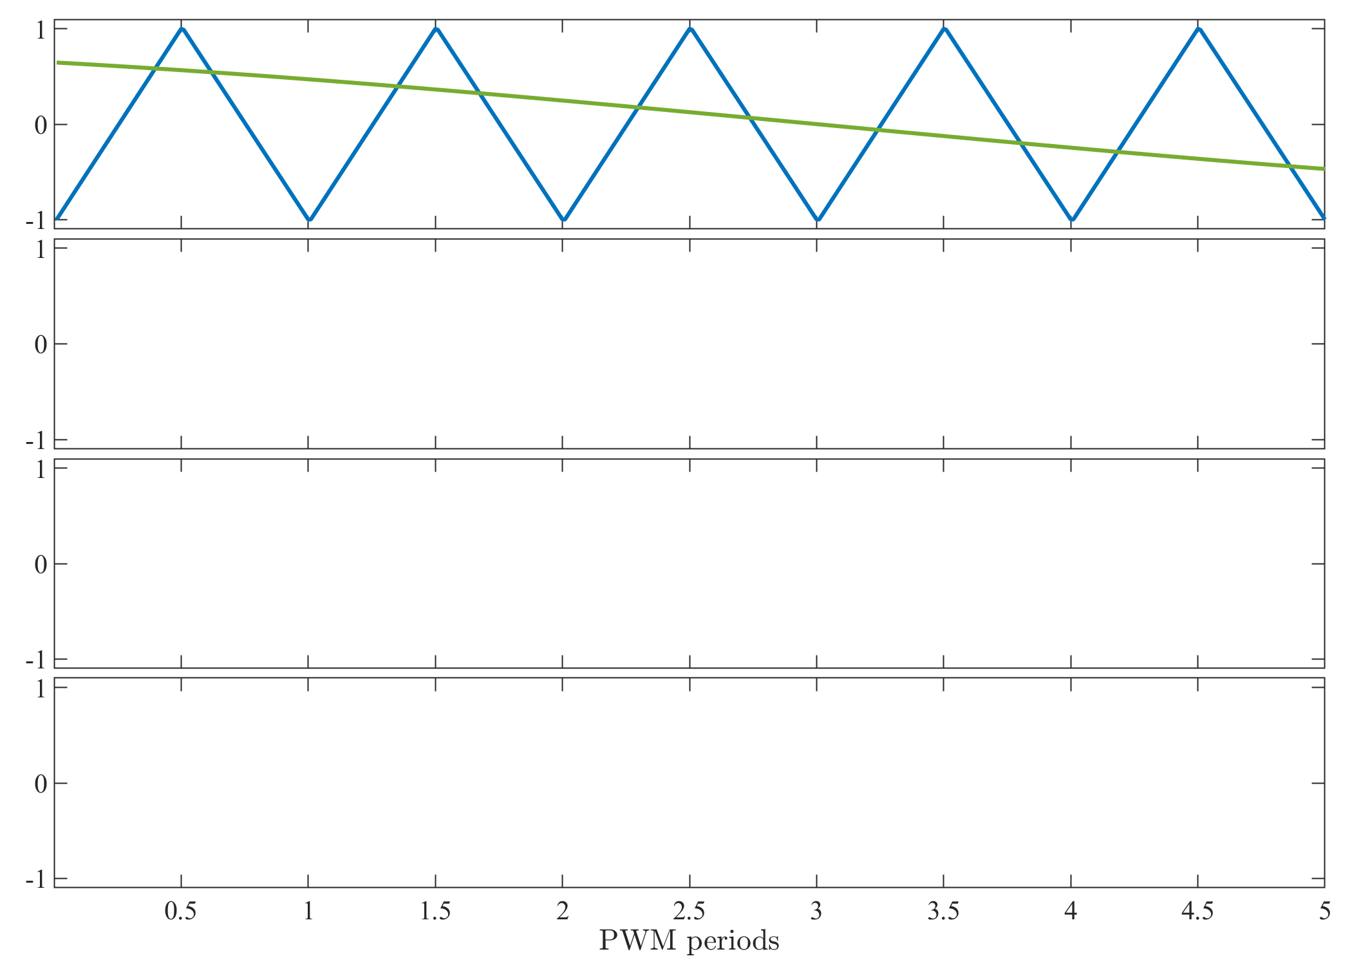
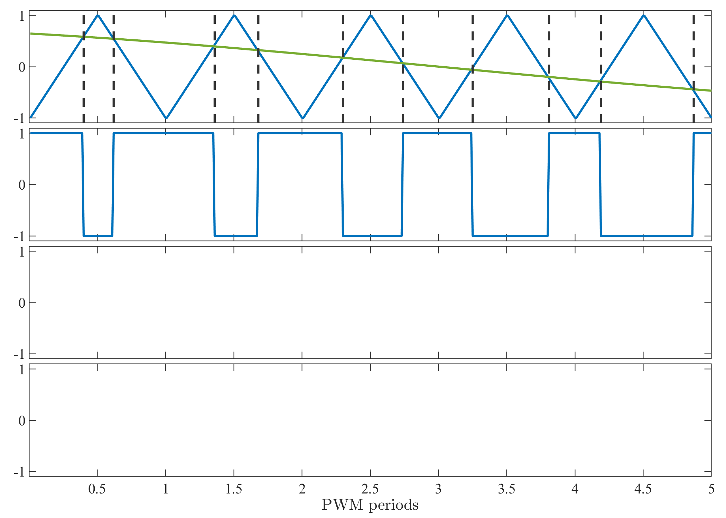
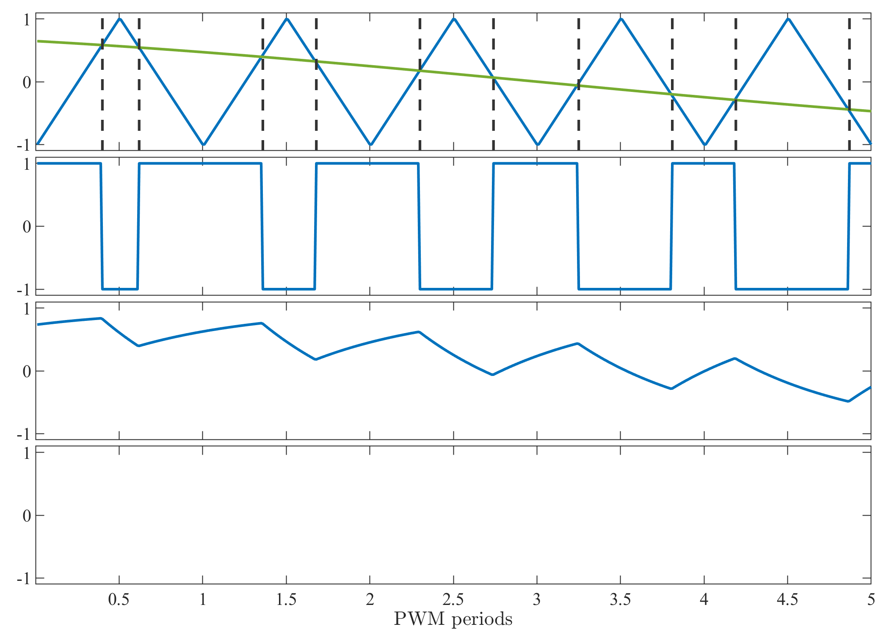
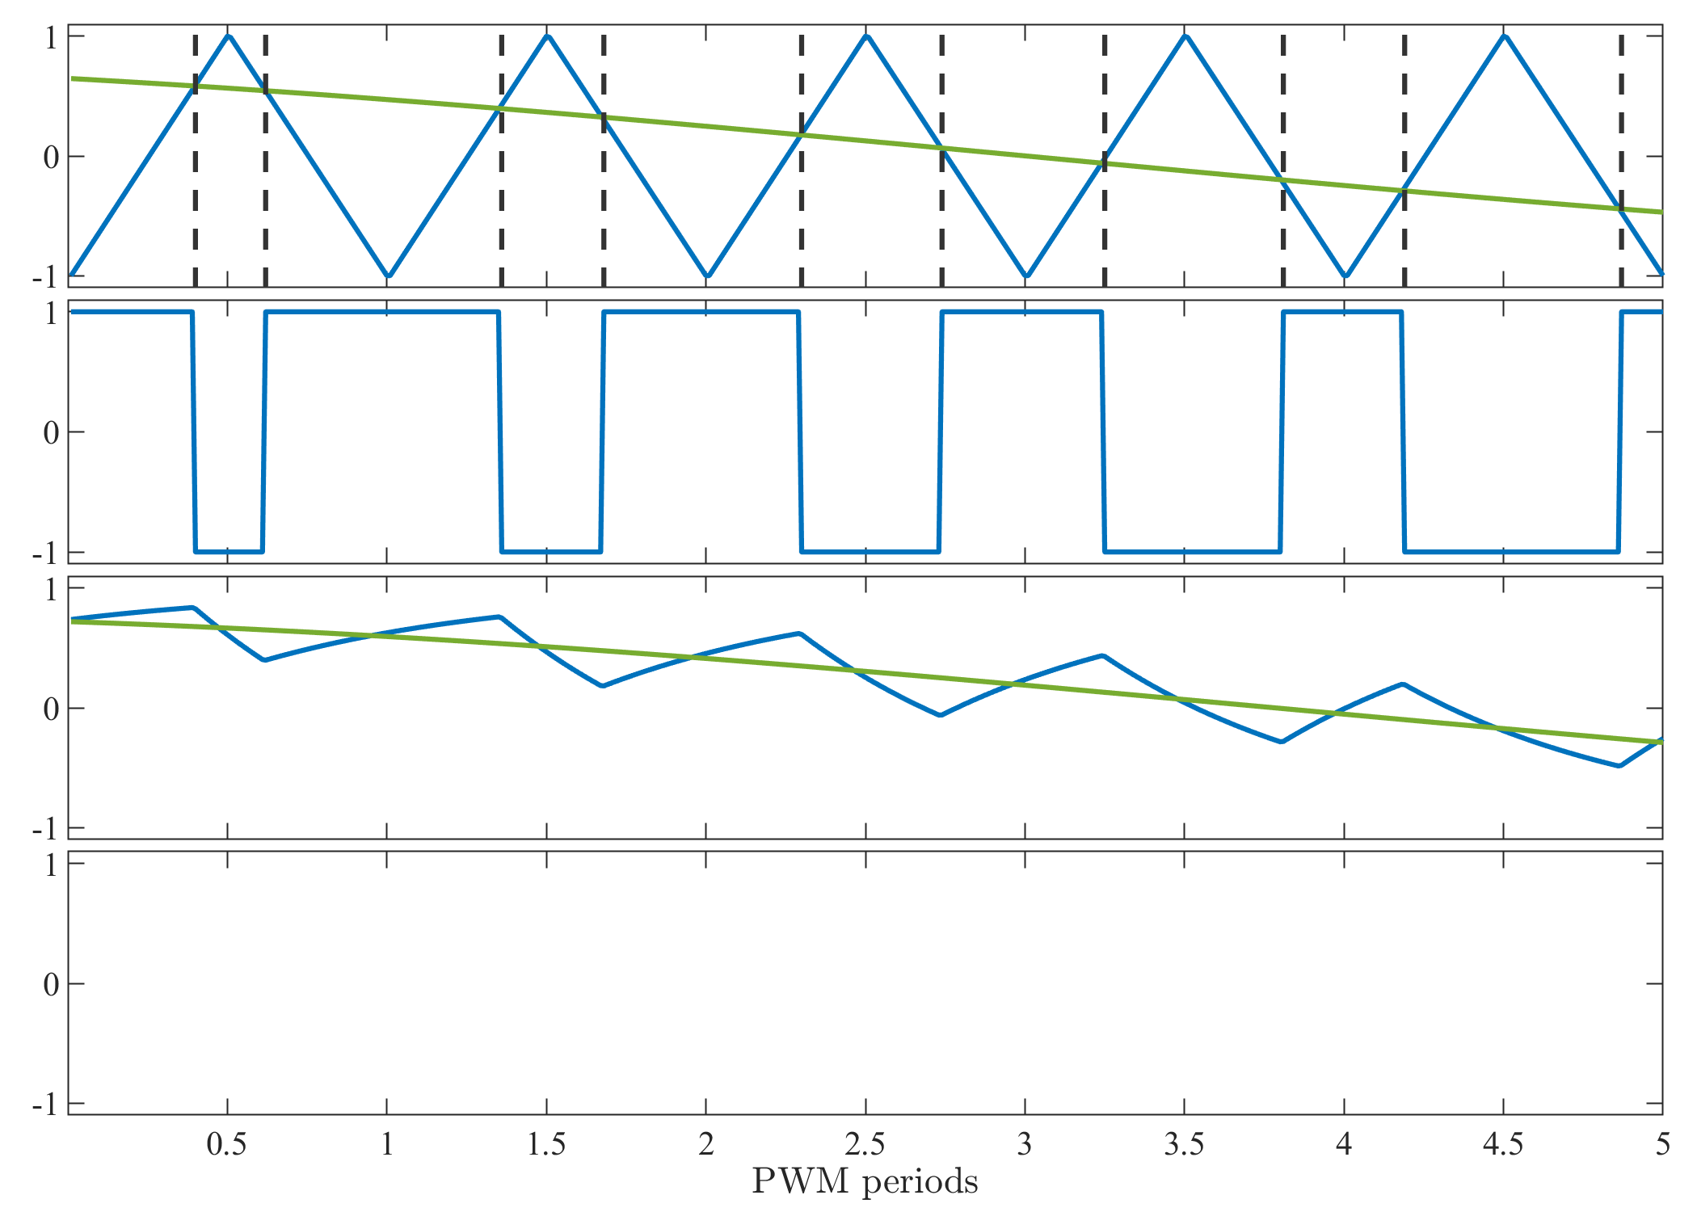
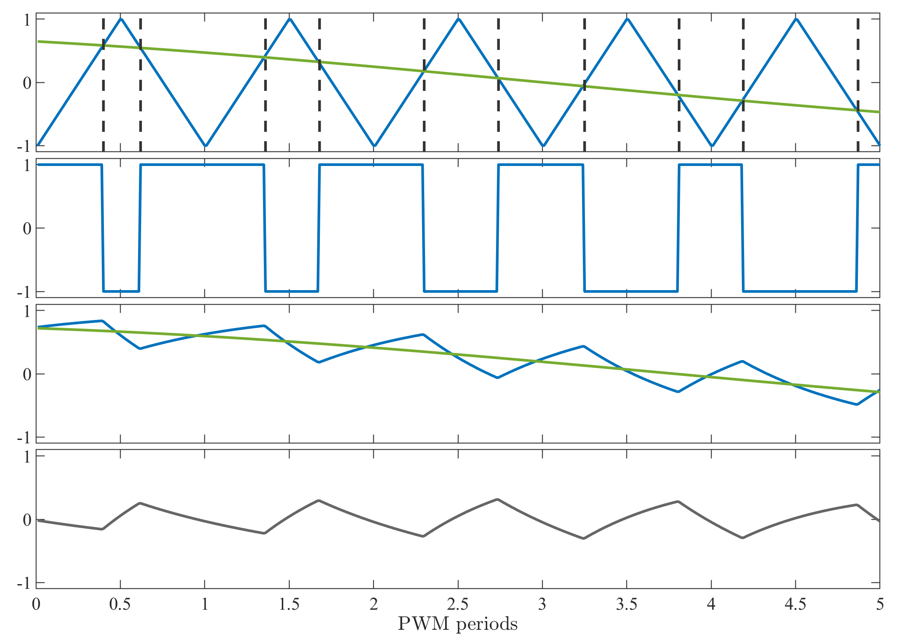
Pulse width modulation (PWM)
Start with low power input u(t)
Compare with ramp waveform Vr(t)
Switching frequency fsw
Amplify digital waveform
LC Lowpass filter
High power output y(t)
Proportional to u(t)
With added ripple Vripple(t)
u(t)
Vr(t)
u(t)
y(t)
Vripple(t)
Notes:
45s
Lets say the small signal we want to amplify is u
***A very easy way to modulate this signal is to compare it to a ramp waveform,
***such as a triangle wave, as shown here
***This ramp waveform defines our switching frequency
***The result of the comparison is a PWM waveform, whose duty cycle is proportional to u
This rectangular waveform can then be passed to a switchmode amplifier, like and H bridge
***We then pass the amplifier output through some LC lowpass filter
***To get a high power output y
***Which resembles the input u,
***but with some residual ripple voltage left over

Slide 6
Pulse width modulation (PWM)
Tradeoffs with f_{sw}
Increasing f_{sw}
Less output ripple for same filter
Higher control bandwidth
More power dissipation
u(t)
Vr(t)
u(t)
y(t)
Vripple(t)
Notes:
10s
The choice of switching frequency is an important system parameter that involves some trade off
***Higher switching frequency makes filtering ripple on the output easier
And allows higher bandwidth signals to be amplified
***On the other hand, higher switching frequency will increase power dissipation in the amplifier

Slide 7
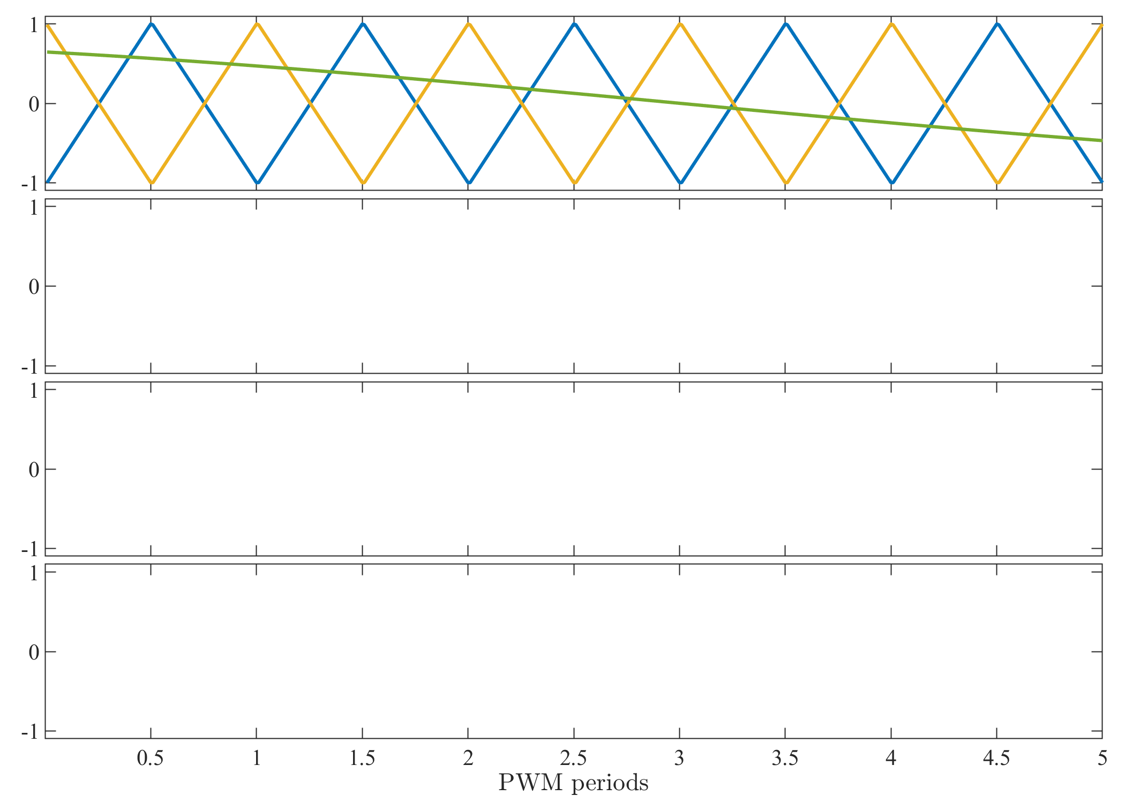
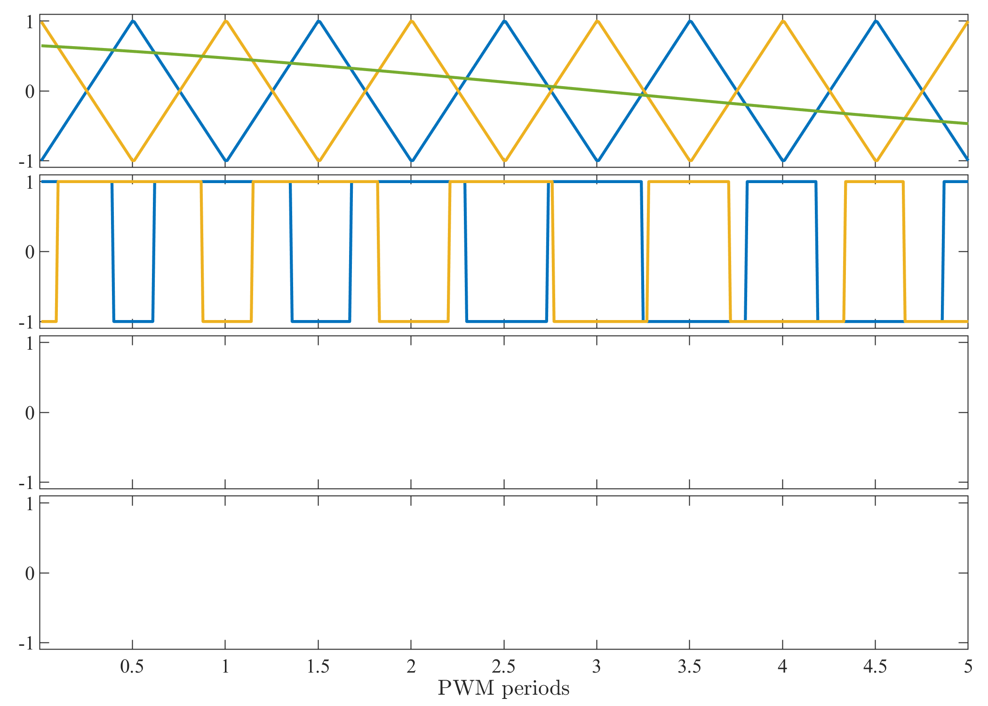
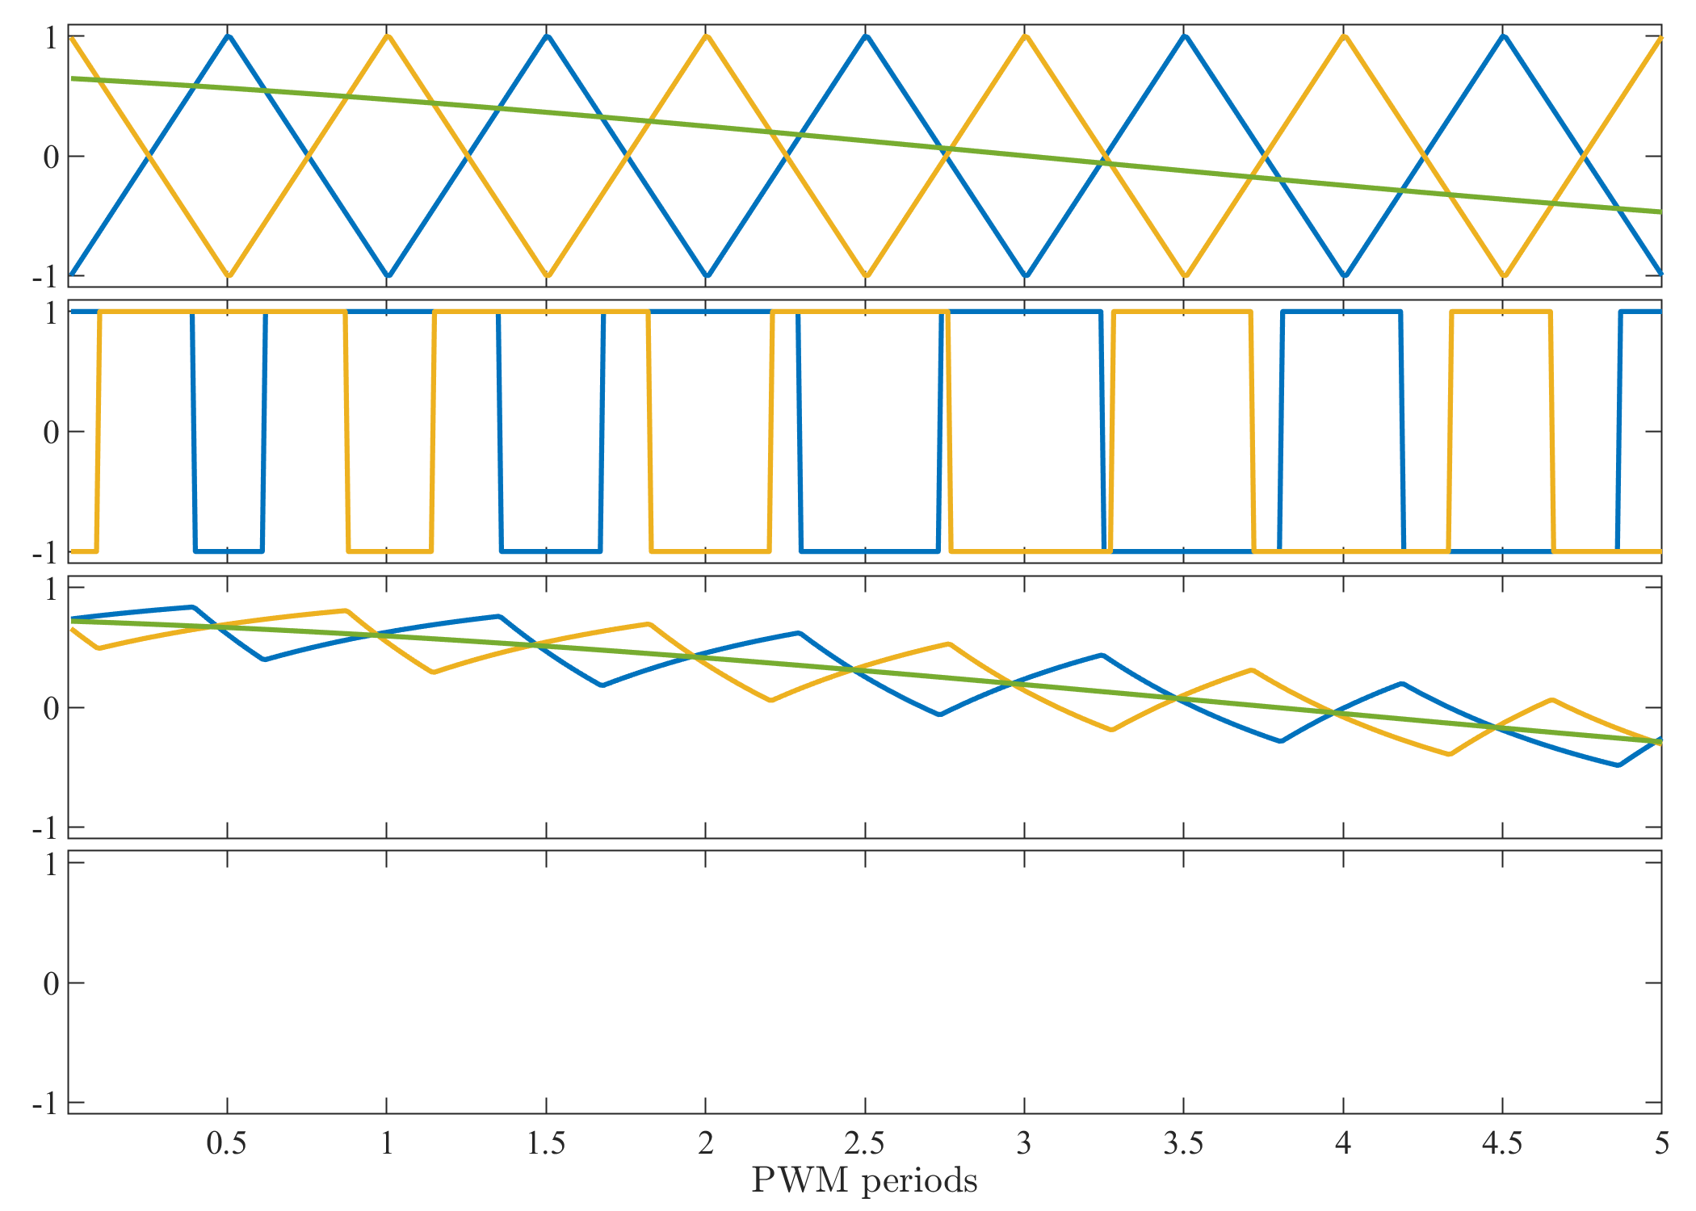
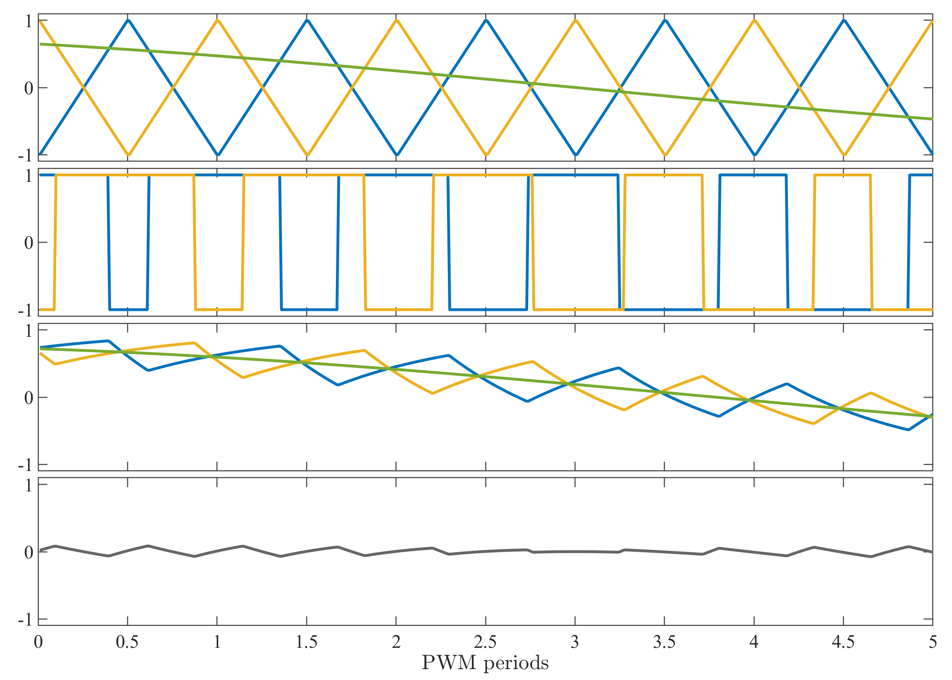
Interleaved PWM (N=2)
Compare with multiple Vr(t)
Each Vr(t) has interleaved phase
Get interleaved PWM
Amplify each PWM waveform
Combine in series or parallel
Ripple cancellation
Vripple(t)
Notes:
30s
One technique which is common in high power applications is interleaved pwm
Here’s a simple example of a two phase interleaved scheme
***I compare my Vin to two ramp waveforms with interleaved phase
***Resulting in two interleaved PWM waveforms,
***which are passed to separate switching amplifiers
***Can combine the two in series or parallel
***And I find that doing so results in partial ripple cancellation at the combined output

Slide 8
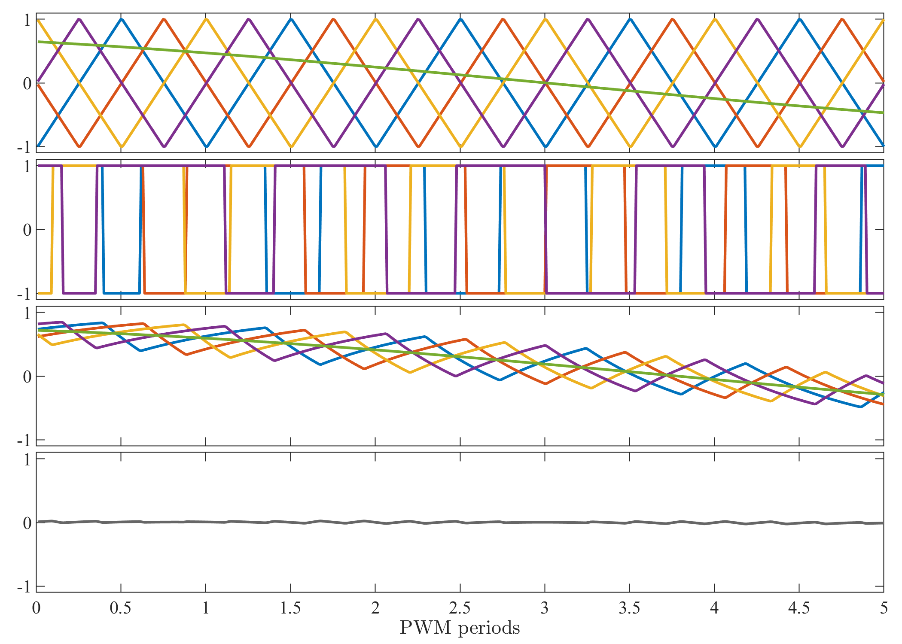
Interleaved PWM (N=4)
Compare with multiple Vr(t)
Each Vr(t) has interleaved phase
Get interleaved PWM
Amplify each PWM waveform
Combine in series or parallel
Ripple cancellation
Effective switching frequency f_{SW}=Nxf_{SW}
No penalty to efficiency
Vripple(t)
Notes:
15s
Here’s what this looks like with N=4 phases, showing even more reduction in ripple
***In fact we can approximate our combined system as having an effective switching frequency multipled by N
***But without the penalty to power efficiency

Slide 9
System overview: PWM modulators
Control
u(t)
Error
e(t)
Reference
r(t)
Controller
PWM modulators
Power stage
Filter
Current sensor
Coil
Σ
+
-
Output
y(t)
Notes:
5s
Now I’m going to show how we implemented the PWM modulators

Slide 10
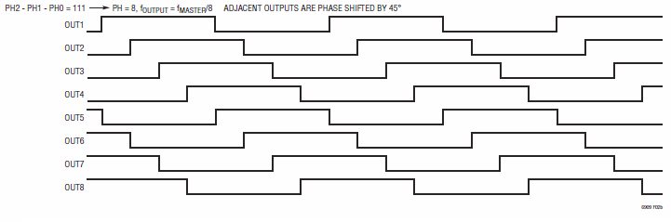
Start with interleaved clocks
Use LTC6909
Generates 2-8 interleaved clocks, D=50%
Capable of SSM (do not use!)
Use demo board DC1446A
Set to 50kHz, use odd phase outputs
Notes:
40s
First thing we need is a circuit which generates interleaved clock waveforms
***To do this we start with the LTC6909 chip from linear technology
***This generates up to 8 interleaved clock signals with 50% duty cycles, as shown here
***The chip is also capable of spread spectrum modulation
However I recommend against using this function, for reasons I don’t have time to explain here
This chip is not available in a through hole package
***But you can get a demo board for the chip from linear technology
***Ours is set up to generate 8 clocks with 50kHz frequency,
But we only use the four odd outputs

Slide 11
PWM modulators
Convert clocks into ramps
Use opamp integrators
Vr_{MIN}=-4V, Vr_{MAX}=4V
Comparators produce PWM
D=(V_{IN}-Vr_{MIN})/(Vr_{MAX}-Vr_{MIN})
V_{MAX}
V_{IN}
V_{MIN}
PWM
Notes:
20s
To convert these clocks into ramp waveforms
***Each is fed to an op amp integrator circuit
The result is a triangular ramp signal with the same phase as the clock
And an amplitude of 8V
***A comparator produces the PWM outputs by comparing a ramp to an analog input Vin
***The duty cycle is given by this formula

Slide 12
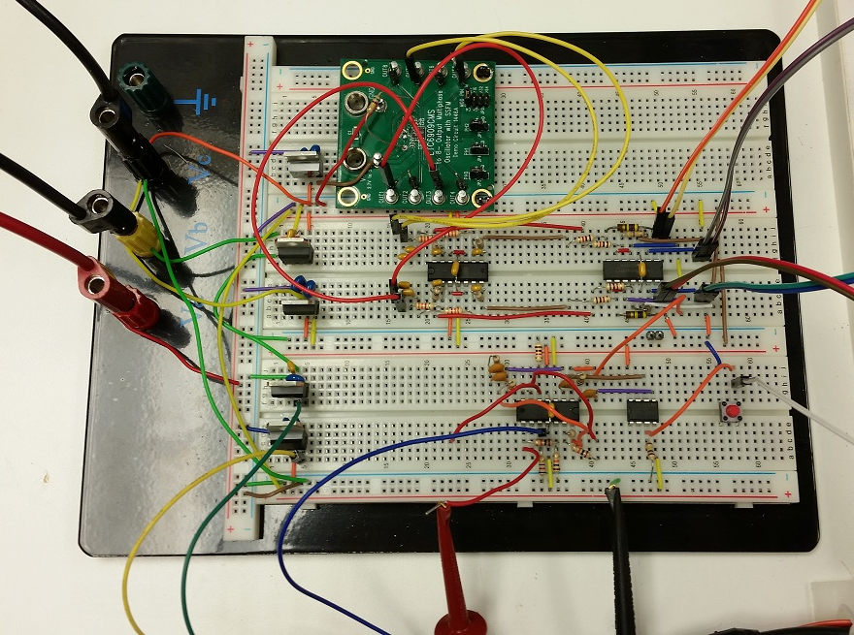
PWM modulators
Interleaved clock board
Integrators
PWM output
cables
DC supplies
+/-15V
PWM comparators
Feedback controller
Notes:
30s
Here’s a photograph of all the control electronics on a solderless breadboard
***The controller is powered from benchtop PSU set to +/-15V
***This green PCB is the demo board which produces the interleaved clocks
***Here are the op amp integrators
And here are the PWM comparators
The PWM outputs are carried to the power stage with these cables

Slide 13
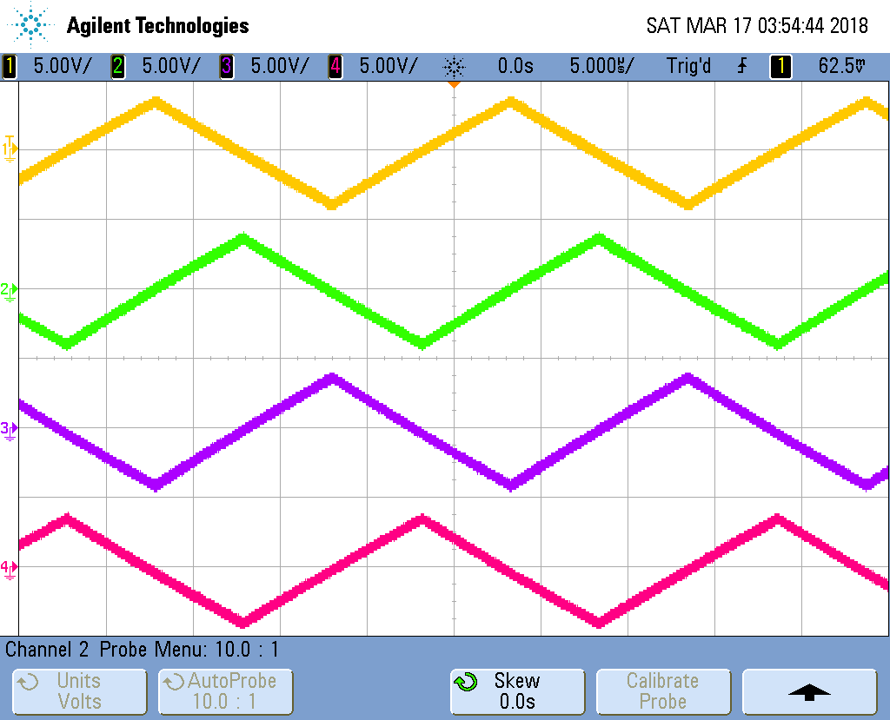
PWM modulators
Notes:
10s
Now lets look at some waveforms from the oscilloscope
Here’s a shot of the four ramp waveforms produced by the integrators
We can see that they’re properly interleaved and have equal amplitude

Slide 14
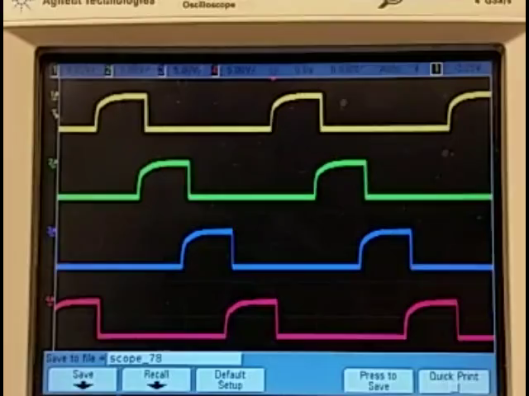
PWM modulators
Notes:
20s
Here is a shot of the outputs of our PWM comparators
It’s important to make sure that their duty cycles are equal, and that they vary smoothly vs the input voltage
This video shows how they change as I apply a varying input voltage

Slide 15
System overview: PWM modulators
Control
u(t)
Error
e(t)
Reference
r(t)
Controller
PWM modulators
Power stage
Filter
Current sensor
Coil
Σ
+
-
Output
y(t)
Notes:
5s
Next we will discuss the power amplifier stage

Slide 16

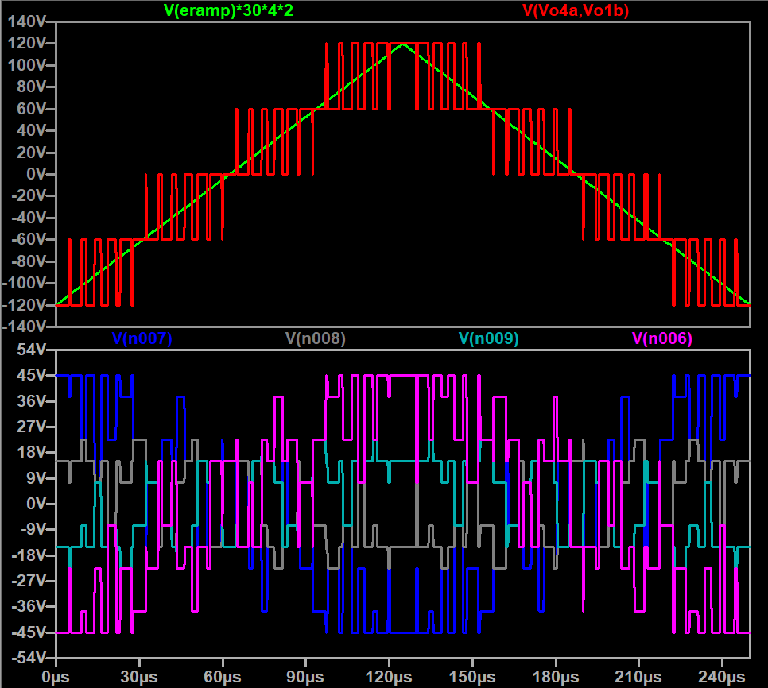
Cascaded H bridge multilevel inverter
Connect N=4 H-bridge outputs in series
Multiplies Vout by 4
Common mode voltages
Must be isolated
V_{DD}
V_{CM4}
V_{DD}
V_{CM3}
V_{out}(t)=NV_{DD}D(t)
V_{DD}
V_{CM2}
V_{DD}
V_{CM1}
Notes:
15s
***This design used four interleaved H bridges in a cascaded multilevel inverter, which is standard in real gradient amplifiers
***Their outputs tied in series, which multiplies the total output voltage range by four
***Here are the waveforms produced by a spice model of our amplifier
The green trace is the analog input, and the red trace is the combined output voltage
***However I also want to emphasize the common mode voltages seen at the terminals of each DC supply
***Plotted here.
We can see that these DC supplies have large common mode swing at high frequencies
***So these supplies must be well-isolated

Slide 17
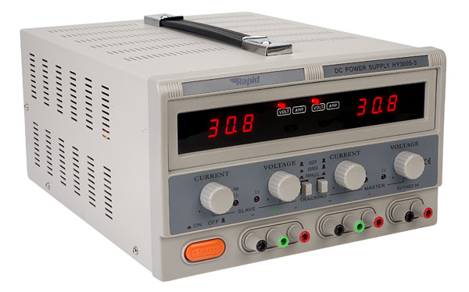
DC supplies
Use isolated PSUs
Isolation isn’t perfect!
Y capacitors from output to earth
Usually ~10nF (8Ω at 200kHz)
Increased power dissipation
PSUs may malfunction!
Solution:
Add common mode chokes
On each DC supply (1mH)
V_{DD}
V_{CM4}
V_{DD}
V_{CM3}
V_{DD}
V_{CM2}
V_{DD}
V_{CM1}
Notes:
35s
***In this work we used common lab power supplies
These have “isolated outputs”
***But no isolation is perfect
***In fact each output has some capacitance to earth, usually around 10nF
***At 200kHz, the impedance of that path is just 8 ohms, which means
Our circuit will cause substantial ripple currents to flow
This will lead to increased power dissipation in the H bridges
And in our case we found that displays on the PSUs actually started to malfunction
Fortunately there’s a simple solution, which is to put a common mode choke on each output
We found a value of 1mH did the trick nicely

Slide 18
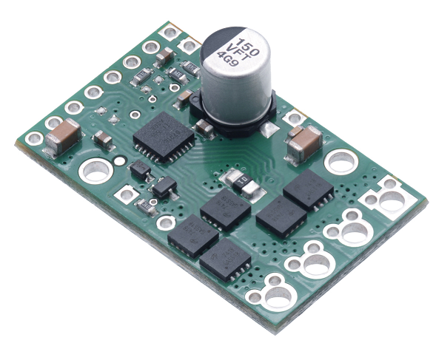
H bridge boards
Bridge of four MOSFETs
Gate driver IC DRV8701
Rated at 40V and 13A
Peak current limit
Current sense output
Reverse polarity protection
f_{SW} up to 100kHz
PWM and Enable signals
Need some external components…
Notes:
40s
Now let’s move on to the H bridges used in this project
To make things easy for beginners, we use premade H bridge modules from Pololu
They contain the four H bridge FETs
And a gate driver IC
The module is rated at 40V and 13A
It has some neat features such as peak current limiting
And reverse polarity protection
It is specified at switching frequencies up to 100kHz
We will operate it using two logic inputs PWM and DIR
Our PWM signal will be applied to the DIR pin
And we can enable or disable the driver by using the PWM pin
(yes, I didn’t mix those up)
However, we need some external components to use it

Slide 19
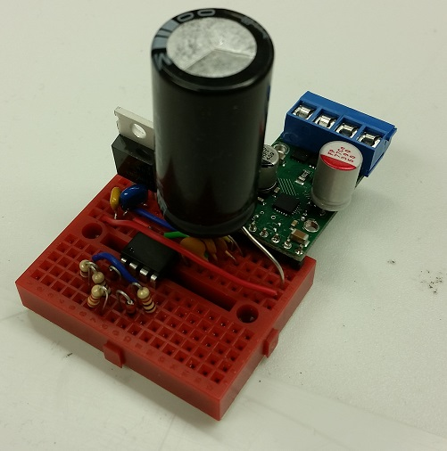
Isolated H bridge units
Motor driver board
Two channel logic isolators (HCPL-2231)
Need 5V supply (LM7805)
Larger DC bus capacitors
See schematics for details…
Notes:
20s
***The H bridge board is here on the schematic
***We need to isolate the logic control signals using a dual channel optoisolator
***And the output side of the isolator needs a 5V supply
***And we’ve also added some extra DC bus capacitors
***There are a few more details that can be found in the repository schematics

Slide 20
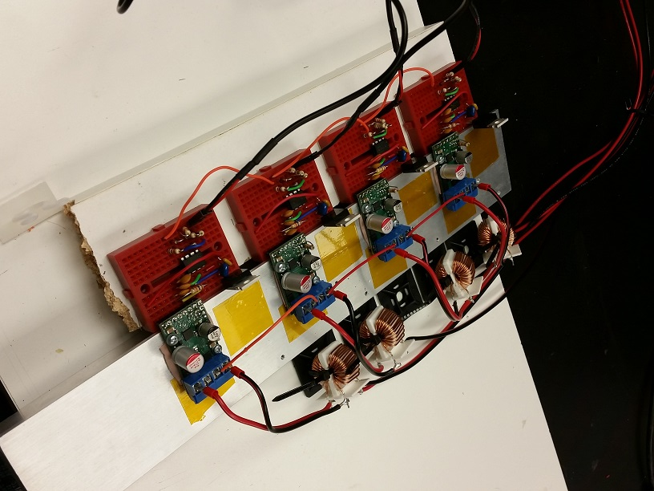
Isolated H bridge units
H-bridge units
=CM chokes
=PWM inputs
=Thermal interface
=Heatsink
Notes:
20s
Here’s a photo of four H bridge units assembled on an aluminum heatink
A thermal interface material is used to insulate the electronics from the heatsink
These cables carry the PWM signals from the comparators
And here are the common mode chokes from the isolated PSUs

Slide 21
System overview: PWM modulators
Control
u(t)
Error
e(t)
Reference
r(t)
Controller
PWM modulators
Power stage
Filter
Current sensor
Coil
Σ
+
-
Output
y(t)
Notes:
5s
Now let’s move onto the output side of the GPA

Slide 22
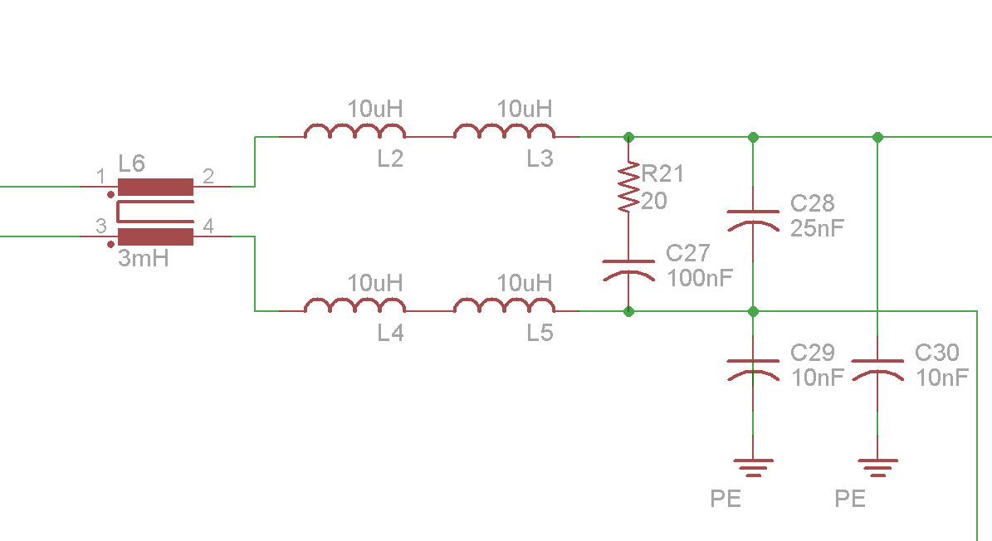
Output filter
Simple LC filter¹
Common and differential mode!
Should not degrade stability margins
Damping helps
Notched filters^{2,3} also an option
Beware of poor gain margin GM!
Differential mode
Common mode
¹Venable H. D. “Minimizing Input Filter Requirements In Military Power Supply Designs,” Venable Industries, 2017.
²Balog R. S. et al “Coupled-Inductor Filter: A Basic Filter Building Block,” IEEE TPE, 2013.
³Sabate J. et al “Ripple Cancellation Filter for Magnetic Resonance Imaging Gradient Amplifiers,” APEC, 2004.
⁴Yu, Huijun. Output Filter Design for Gradient Amplifier and Shimming Amplifier of MRI. ISMRM 2018, #4428.
Notes:
(old 435s by now)
500s by now
30s
For this work we used a simple LC filter design, shown here
***Remember we need to attenuate not only differential mode ripple
But also common mode signals
***Hence why we include a common mode choke and these capacitors to earth
***Also we want to make sure the filter doesn’t degrade our stability margins
***Which is why a we used a damped filter design
***Notched filter design is also an option,
***But we should closely watch what happens to the gain margin

Slide 23
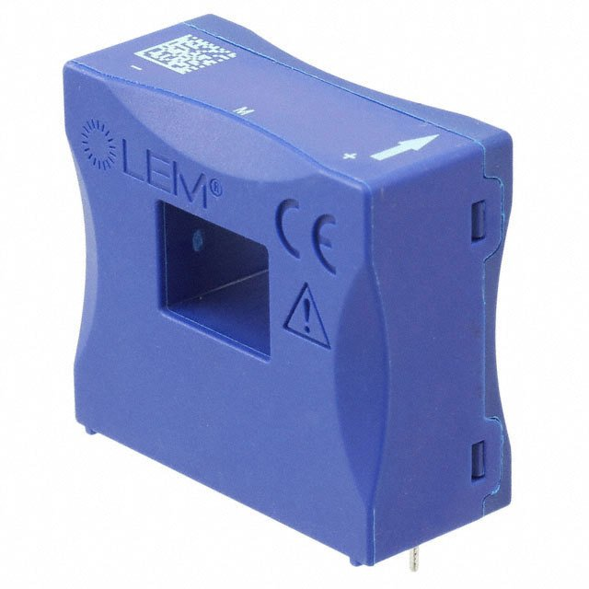
Load current sensor
Primary bottleneck on performance
Noise, bandwidth, drift, etc
Use closed loop hall effect sensor
LA 130-P (LEM)
Use N_{P}=4, R_{M}=62Ω
Get 250mV/Amp sensitivity
Notes:
25s
The choice of current sensor is going to be a primary bottleneck on performance
***Including noise, bandwidth, and drift
***For this work we use a closed loop hall effect sensor
I like these sensors because they are very flexible
***And we can tailor their sensitivity by choosing the number of turns
And the sense resistance
***Here we configure the sensor to have a sensitivity of one volt per every 4 amps

Slide 24
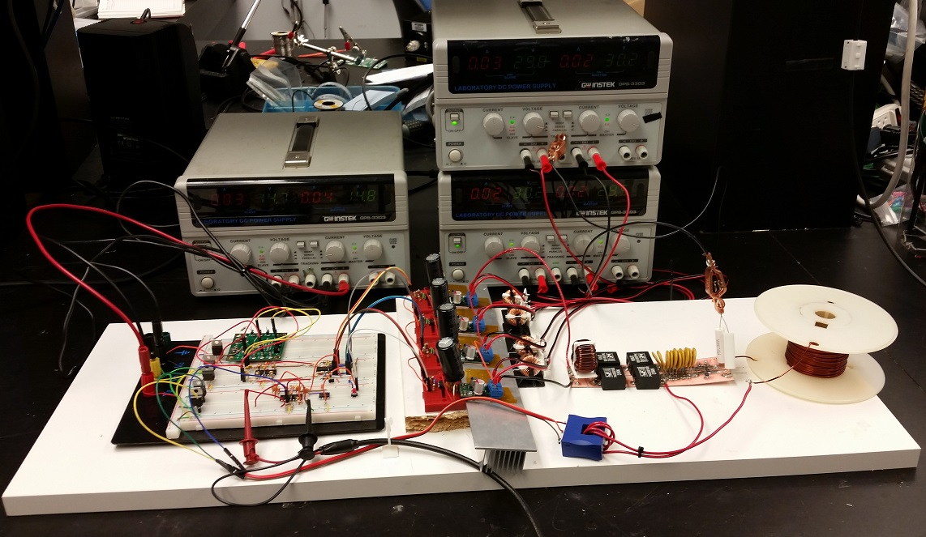
Full GPA setup
Ripple filter
Test coil
273uH
Current sensor
Notes:
500s by now
20s
Here is a photograph of the full system setup.
***Including our ripple filter
***And the output current sensor
***For a test gradient coil, I just wound a solenoid of magnet wire which turned out to be 273uH
But before we power things up for real, we should talk about high voltage safety

Slide 25


HV safety
Shock hazard occurs when the human body becomes part of a return path for current due to a HV potential (>48V)
Example: bird on a power line is safe
Human standing on conductive earth: not safe!
L
220V
N
PE
Notes:
45s
Electrical shocks happen when the human body becomes part of a return path in an electrical circuit
***Let’s consider the classic example of birds sitting on power distribution lines.
A bird is safe touching either the neutral or hot, so long as it only touches one wire, since there’s no return path through the bird
***However if a person touches just one line while standing on a conductive earth surface, they will likely get a shock
***This is because all power transmission systems connect to earth at various distribution points

Slide 26
HV safety
Shock hazard occurs when the human body becomes part of a return path for current due to a HV potential (>48V)
Example: bird on a power line is safe
Human standing on conductive earth: not safe!
At high frequencies, don’t trust isolation
L
220V
N
PE
Notes:
45s
***Even in the case where there’s an isolation transformer not connected directly to earth
***We shouldn’t trust that isolation to keep us safe when high frequency signals are involved, such as our amplifier

Slide 27
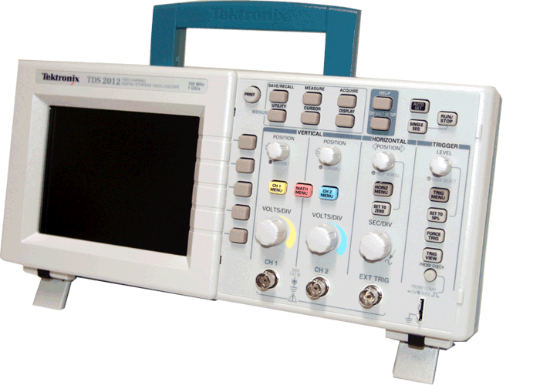
HV safety: Earth ground
In the lab, floor should be insulated
Most hazard require two touches
Electronic equipment, faceplates, cabling, plumbing, etc
L
220V
N
Insulated floor
PE
Notes:
30s
Now in a laboratory, the floor we stand on is usually insulated, so we can often rule that out as a return path
***Therefore most shock hazards in the lab will require both arms
***However, most of our equipment in the lab is going to be earth grounded
***And thus they will also serve as a return path for shocks
***Along with electric faceplates, cabling, and of course plumbing

Slide 28
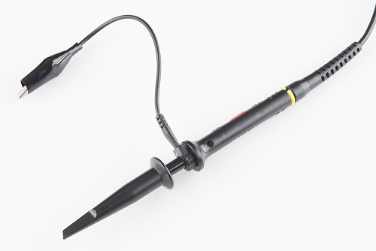
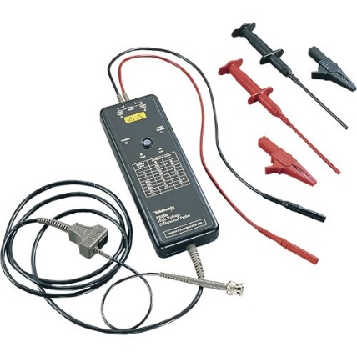
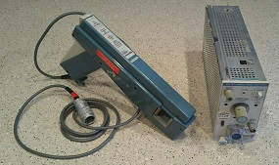

HV safety: safe measurements
Only connect safe instruments to HV side
Voltage probes
HV differential probes (Tektronix P5200)
Poor man’s solution: Use two oscilloscope channels, subtract
Current probes
AC-DC current probes (Tektronix A6302, A6303, AM503)
Poor man’s solution: wire up you own hall effect sensor
USD200-300$
USD10-50$
USD300-500$
Notes:
60s
Here I’m going to discuss the types of equipment you can safely connect to a high voltage circuit
without creating dangerous return paths
First of all, for probing voltage,
don’t even think about touching that ground clip to the power stage
For probing voltage, you should use a high voltage differential probe.
A set can be had on ebay for 200-300$.
The poor man’s option is to take two normal oscilloscope probes, measure two HV with respect to earth, and subtract the measurements
However the common mode rejection ratio of this methods is quite poor
For probing current, I recommend getting an AC-DC current probe such as these models from Tektronix
A combination of a probe and amplifier will run you $300-500 via ebay.
A decent compromise is to use a cheap hall effect sensor, with our own wiring

Slide 29
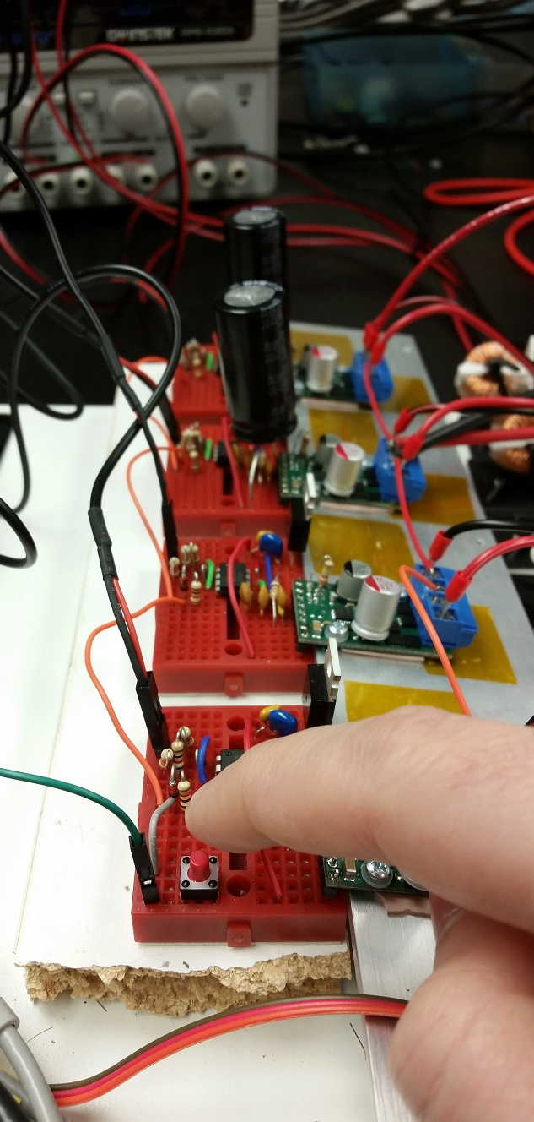
HV safety: rules of thumb
Don’t touch or modify HV circuitry while powered up!!
Tie everything else to earth potential:
Control circuitry
Heatsinks, enclosures, etc
Momentary switch enables H-bridges
“Dead man’s switch”
On low voltage control side
Notes:
645 by now
60s
Obviously we should never touch or modify the HV circuitry while it’s powered on
***For safety’s sake everything else should be connected to earth ground
***Including the control circuitry
And any heatsinks or chassis in the system
As an additional safety measure, the default state of the amplifier should be inactive
***So we add a momentary switch which has to be held down to activate the outputs
***Thus we would call this a dead man’s switch
Since this switch is part of the user interface,
***it is located on the low voltage control side of the isolation barrier

Slide 30
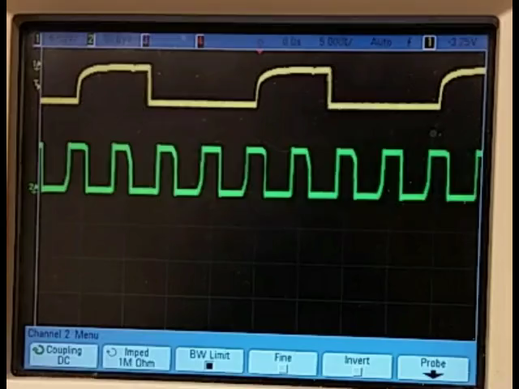
Power stage output
Single PWM
5V/div
Combined Vout
50V/div
Notes:
20s
Now we can safely power up our circuit and take a look at the HV output using our differential probes
Here the yellow trace is one of our low voltage PWM logic signals,
While the green trace is the HV output of our H-bridge cascade
We can see the multiplication of the switching frequency and the multilevel behaviour

Slide 31
System overview: Controller
Control
u(t)
Error
e(t)
Reference
r(t)
Controller
PWM modulators
Power stage
Filter
Current sensor
Coil
Σ
+
-
Output
y(t)
Notes:
5s
***Finally, we’ll complete our journey by covering the feedback controller
Here, all of our analysis is going to be in the frequency domain

Slide 32
System overview: Controller
Control transfer function H(f)
Open loop gain transfer function G(f)
The Controller
The “Plant”
Control
U(f)
Error
E(f)
Reference
R(f)
Controller
PWM modulators
Power stage
Filter
Current sensor
Coil
Σ
+
-
Output
Y(f)
Notes:
10s
***All the components we’ve covered up until now comprise the so-called “plant”
***Which has an open loop transfer function G(f)
***The rest of the system is the control,
***which has transfer function H(f)

Slide 33
System overview: Controller
Control transfer function H(f)
Open loop gain transfer function G(f)
Control
U(f)
Error
E(f)
Reference
R(f)
Controller
PWM modulators
Power stage
Filter
Current sensor
Coil
Σ
+
-
Output
Y(f)
Loop gain HG(f)
Notes:
10s
Together these make up
***the loop gain HG of our system
Which determines the system’s stability

Slide 34
Loop stability of HG
Conditions for magnitude |HG(f)|:
At f → 0, |HG(f)| >> 1
At f → N f_{sw}, |HG(f)| << 1
Crossover frequency f_{C} is the frequency at which |HG(f)|=1
Higher f_{C} is better, but typically limited to f_{C} <N f_{sw} /5
0Hz
f_{C}
N f_{sw} /2
|HG(f)|
0dB
Notes:
40s
Lets describe some general properties of the loop gain
***At very low frequencies, we want the loop gain to be very high, such that errors are suppressed
However, we don’t want the feedback loop to act on the high frequency ripple
***Therefore at the PWM switching frequency, the loop gain should be very low
Also keep in mind that the small signal gain can only be well defined up until half the effective switching frequency
***In between these two extremes, the loop gain must cross through unity gain. This is referred to as the crossover frequency fc
***In general, the higher the crossover frequency the better, but in practice we are usually limited to less than one fifth of the effective switching frequency

Slide 35
Loop stability of HG
Conditions for phase ∠HG(f):
∠HG(f) > -360° for f < f_{C}
∠HG(f_{C})+360° is referred to as phase margin (PM)
Typically want 45° < PM < 60°
Above f_{C,} ∠HG(f) may eventually cross -360°
The magnitude of HG(f) at that frequency is the Gain Margin (GM)
0Hz
f_{C}
N f_{sw} /2
|HG(f)|
∠HG(f)
0dB
0°
GM
PM
-360°
Notes:
40s
The phase of our loop gain is also critical for evaluating stability
***Below our cutoff frequency, the loop gain’s phase lag should be less than -360 degrees
***The amount of margin between the actual phase lag and -360 is referred to as the phase margin
***Typically we aim for a phase margin between 45 and 60 degrees
***Above the crossover frequency, the phase lag will may eventually cross the 360 threshold
***The loop gain at this point is referred to as the gain margin
And we typically want this to be lower than -6dB

Slide 36
How do we design H(f)?
Many methods available
We will use K-factor approach
Need to specify f_{C}, PM
Need to know G(f_{C})
Measure G(f_{C}) Empirically
Venable H. D. “The K Factor: A new Mathematical Tool for Stability Analysis and Synthesis,” Venable Industries, 1983
Venable H. D. “ Optimum Feedback Amplifier Design for Control Systems,” Venable Industries, 2017
Notes:
30s
So these are basic criteria our controller has to satisfy,
but how do we actually design the controller transfer function H?
There are numerous methods available, and the one I tend to use is called the k factor method
I won’t be going into details, but it’s a fairly straightforward plug-and-chug method
All you need to know is your desired crossover frequency and phase margin
And the value of the plant transfer function at that crossover frequency
G can be derived through simulation, or measured empirically

Slide 37
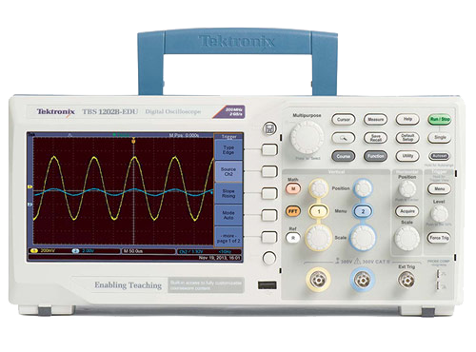
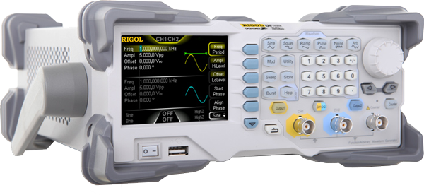
Measuring SS transfer functions
Reference
r(t)
Error
e(t)
Controller
PWM modulators
Power stage
Filter
Current sensor
Coil
Σ
+
-
Output
y(t)
Control input
u(t)
Break the loop at u and y
Drive input u with sine wave
Select amplitude and DC offset carefully!
Measure u and y with oscilloscope
Record amplitude and phase
Notes:
30s
Here I’m going to walk you through how to measure the transfer function of the plant
***First we will break the feedback loop
***So that we can apply a sinusoidal stimulus using a function generator
***When doing this, we must be careful that the amplitude and offset of this input is puts the system in a linear operating range
In this case I chose a bias that point of one amp at the output
***We’ll use an oscilloscope to probe u and y simultaneously
***And measure their relative amplitude and phase
But in practice there are a few tricks to this

Slide 38
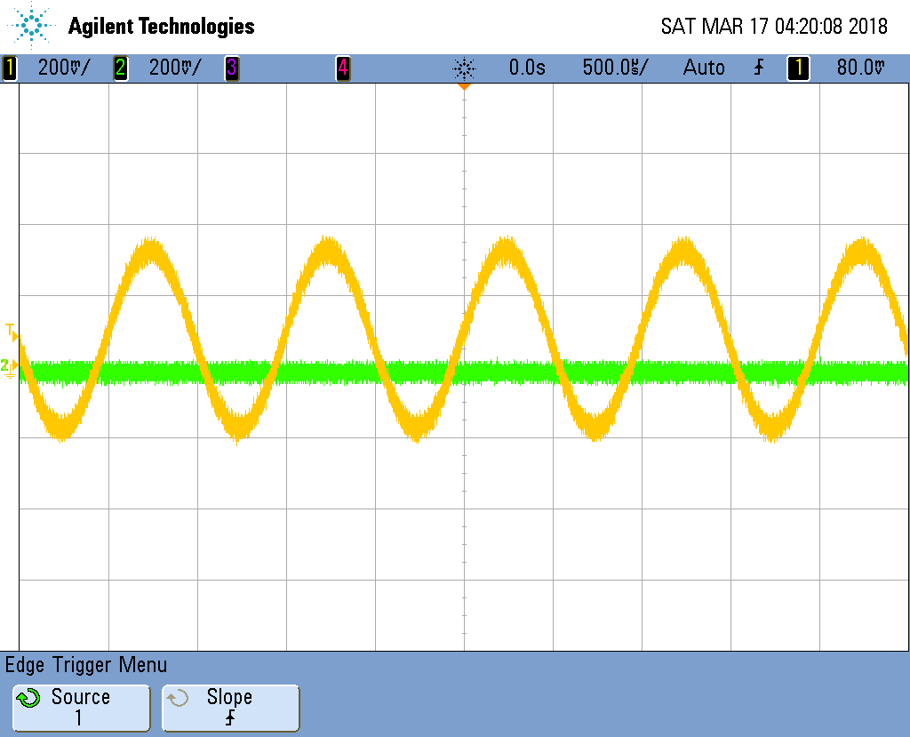
Example SS gain measurement
Default scope settings
Amplifier disabled
Channel 1: u(t)
Channel 2: y(t)
Trigger scope on u(t)
Enable PWM…
Notes:
875 by now
15s
Here we see an oscilloscope trace of our input u in yellow
And the output y in green
The oscilloscope is triggering on the input u
The H bridges are currently disabled, so which is why the output shows no response

Slide 39
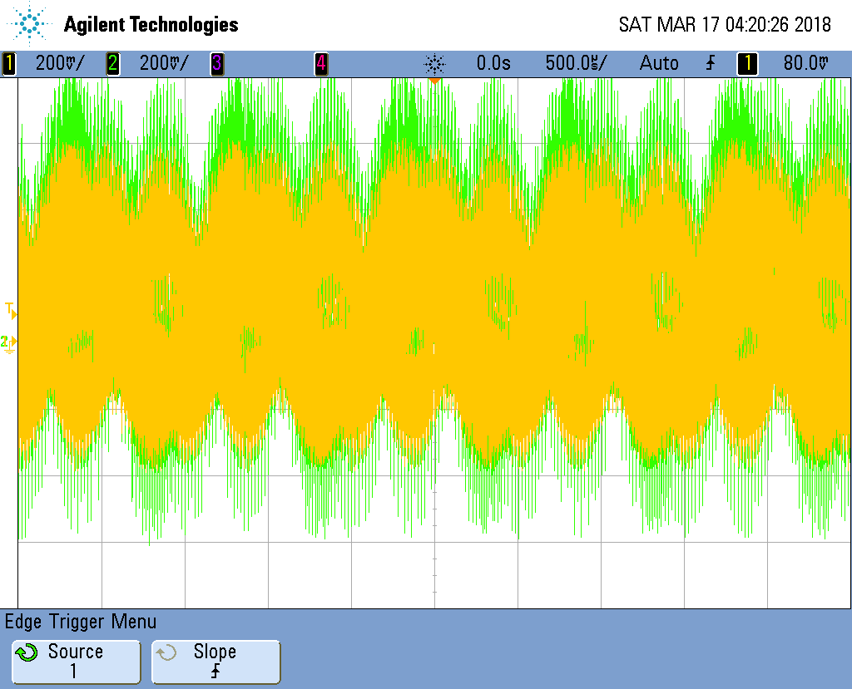
Example SS gain measurement
Default scope settings
Amplifier disabled
Channel 1: u(t)
Channel 2: y(t)
Trigger scope on u(t)
Enable PWM…
Switching interference!
Trigger is unstable
Don’t trigger on u(t)
Notes:
10s
Now if we enable the h bridges we see something like this
The interference and ripple from the H bridges is so severe that we can’t even get a stable trigger

Slide 40
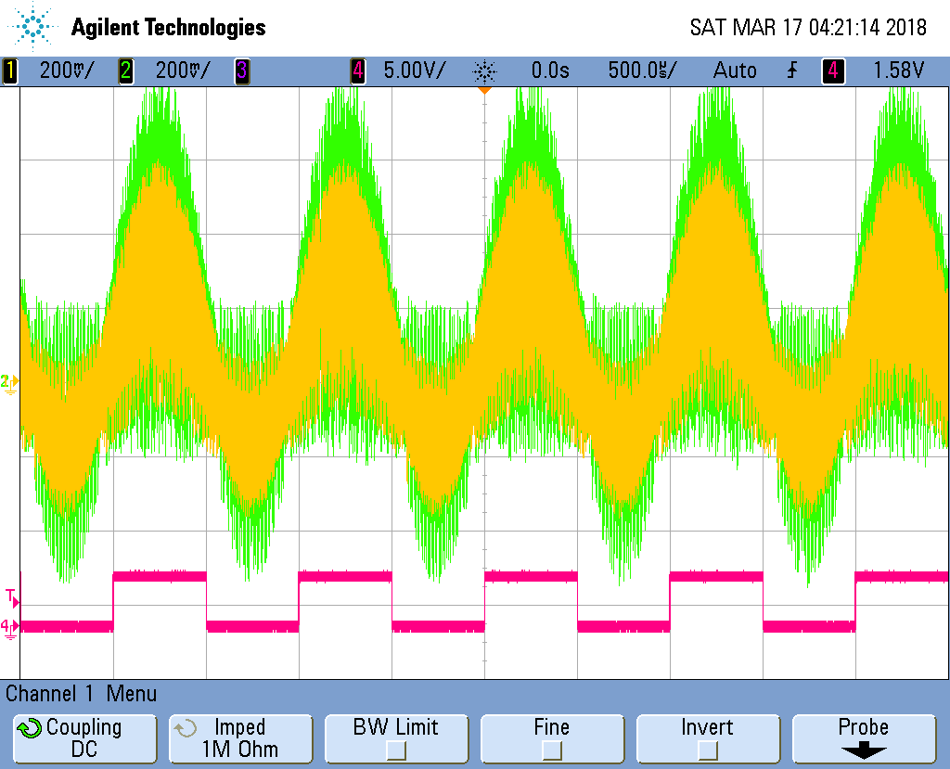
Example SS gain measurement
Use function generator sync output for trigger
Notes:
20s
An easy way to solve the triggering problem is to use a separate trigger signal
Most function generators have sync outputs which are meant for this purpose
Here we show the sync signal in pink, which is not contaminated by the interference
But our other signals still are

Slide 41
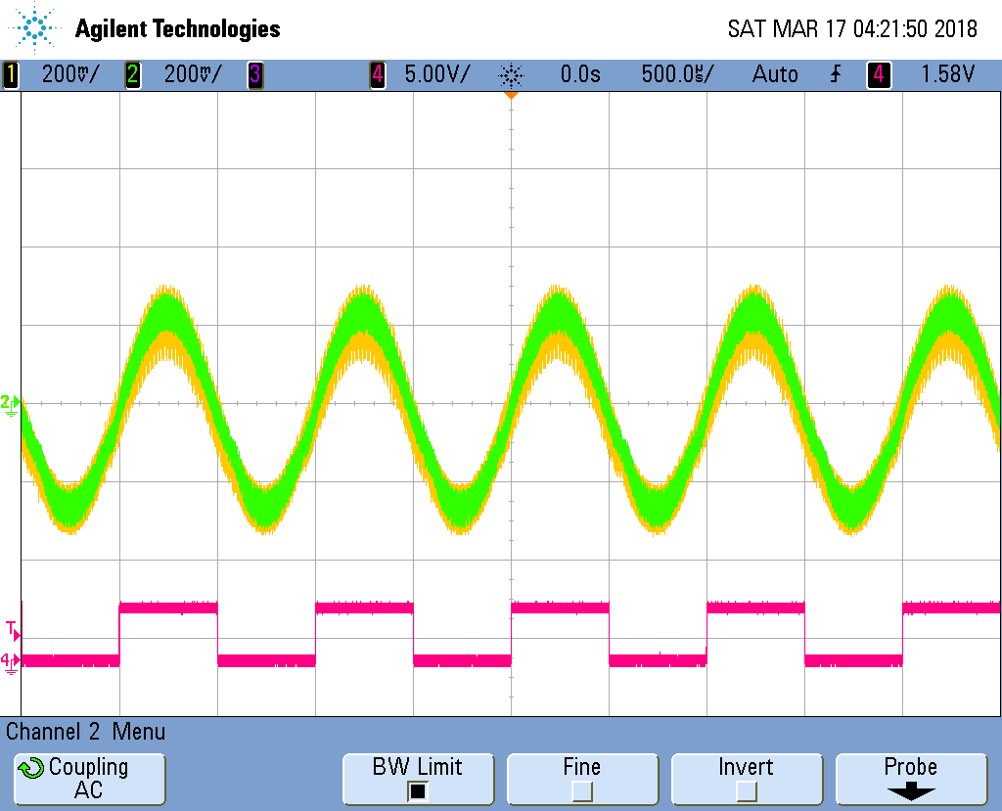
Example SS gain measurement
Use function generator sync output for trigger
Bandwidth limit
Reduces very high frequency content
Notes:
10s
To further clean up the signals, we can use the oscilloscope’s internal bandwidth limiting function
It’s improved, but still not good enough for accurate measurements

Slide 42
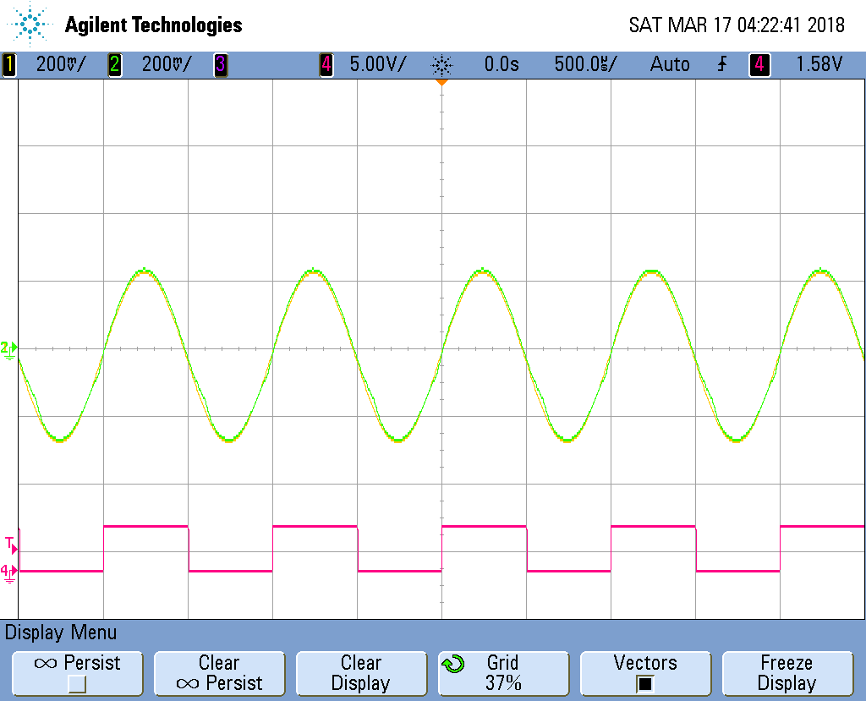
Example SS gain measurement
Use function generator sync output for trigger
Bandwidth limit
Reduces very high frequency content
Averaging acquisition mode
PWM signals are incoherent relative to the trigger
Interference is averaged out
Notes:
15s
A much better method is to change our acquisition mode to averaging
This multiple successive sweeps, which causes incoherent interfering signals to cancel out

Slide 43
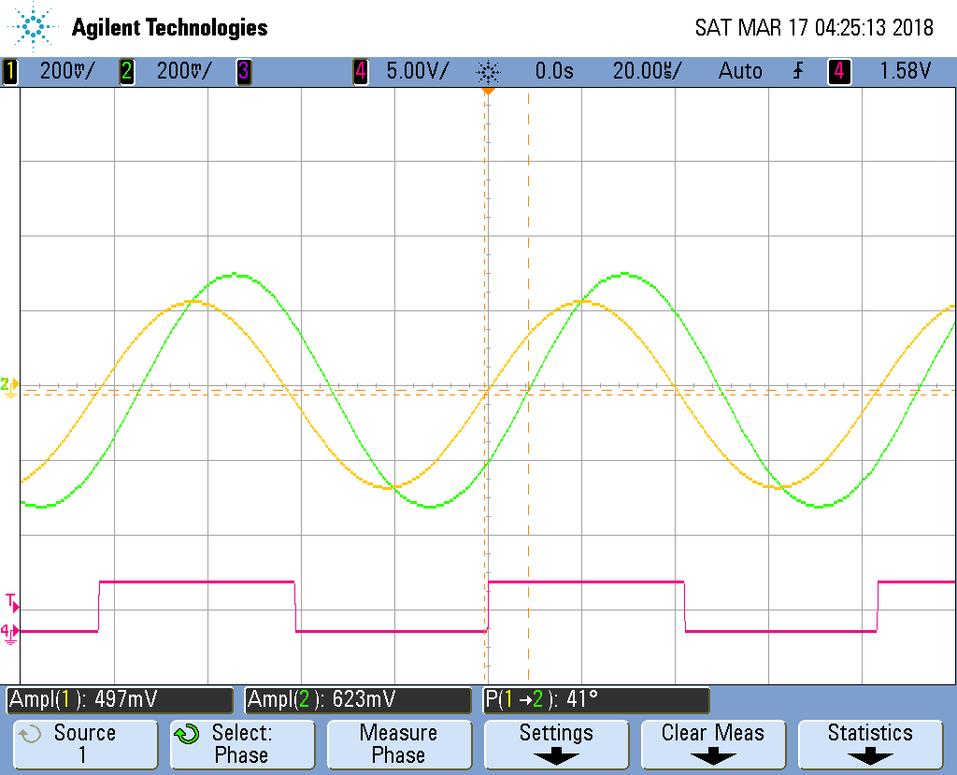
Example SS gain measurement
Set up quick measure
Amplitude
Phase
Manually step frequency
Notes:
10s
We then set up our quick measurements
In particular we want the amplitude of both signals and the relative phase
We can then sweep the frequency as we like

Slide 44
Compensator implementation
Error amplifier is a difference amplifier (G=1)
Compensator (type III) is an active filter with 3 poles, 2 zeros
K-factor method derives all component values
Notes:
955 by now
20s
Here’s what our controller circuit will look like
***A differential amplifier circuit implements the error amplifier
***And the controller H is an active filter with three poles and two zeros
This is what’s known as a type III compensator
***The k factor method will give you all the component values for this stage
***Remember, when you first close the feedback loop, be careful that the overall feedback is negative!

Slide 45
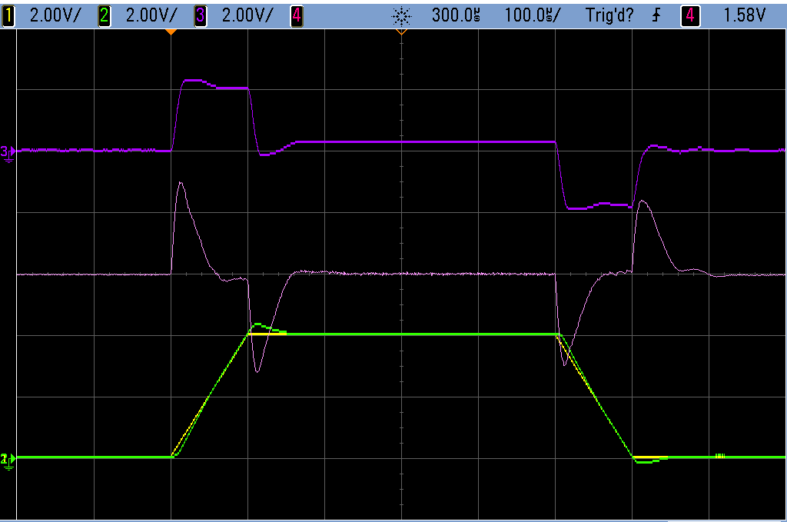
Example closed loop response (16A step)
Trapezoidal pulse
100µs/div horizontal
8.0A/div vertical
Well-damped
Steady state error near zero
Settling time ≈1/f_{C}
Reference
r(t)
Error
e(t)
Control
u(t)
Output
y(t)
+
Controller
H(f)
Plant
G(f)
Σ
-
Notes:
20s
Here is the transient response of the closed loop system to a small, fast pulse of 16 amps
***We see the reference,
***the output current,
***the error,
***And the controller output
***The error signal shows that the system is well damped
***And the settling time is roughly the inverse of our crossover frequency
***We also see near zero steady state error during the plateau

Slide 46
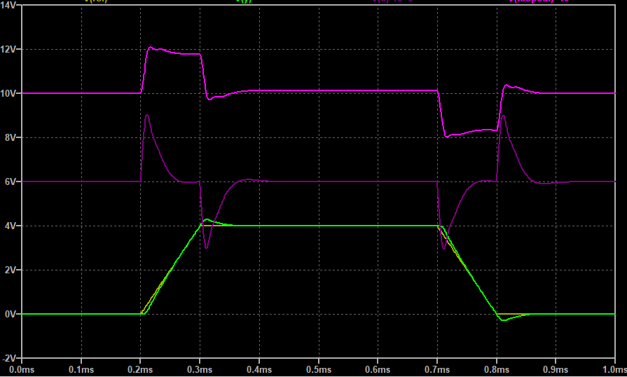
Closed loop response (16A step)
Measured response
Simulated LTspice model
Notes:
10s
If we simulate the same pulse for the Ltspice model of the GPA
We get very similar results
However these waveforms so far only use positive current

Slide 47
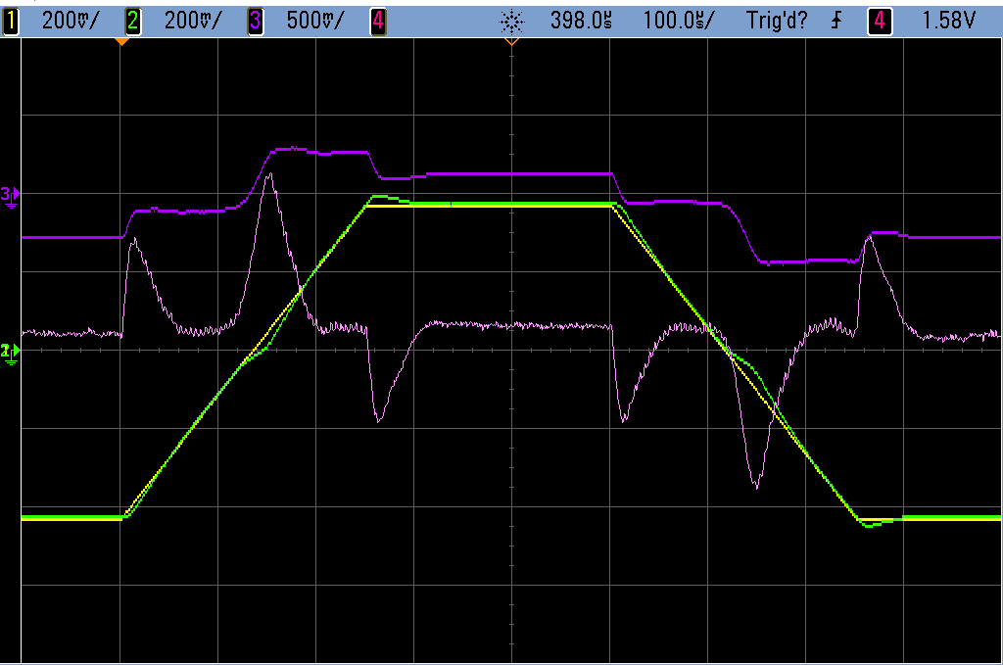
Zero crossing distortion
Trapezoidal pulse
100µs/div horizontal
0.8A/div vertical
Crossover distortion due to dead time in H-bridges
Effective G(f) is smaller when y biased near zero
Could be corrected with feedforward
Notes:
20s
When the current passes through zero, we get crossover distortion
***This distortion is due to the dead time of the H bridge controllers
***When operating near zero load current, the small signal transfer function will be much lower
***In practice this distortion should be mitigated using feedforward control

Slide 48
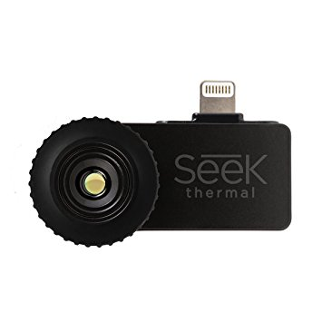
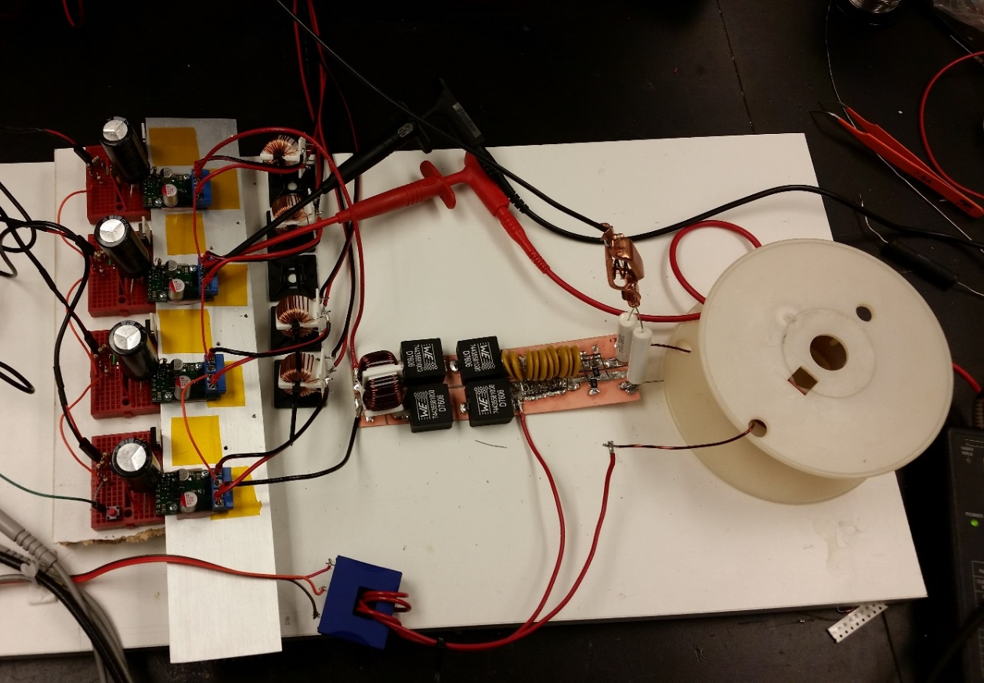
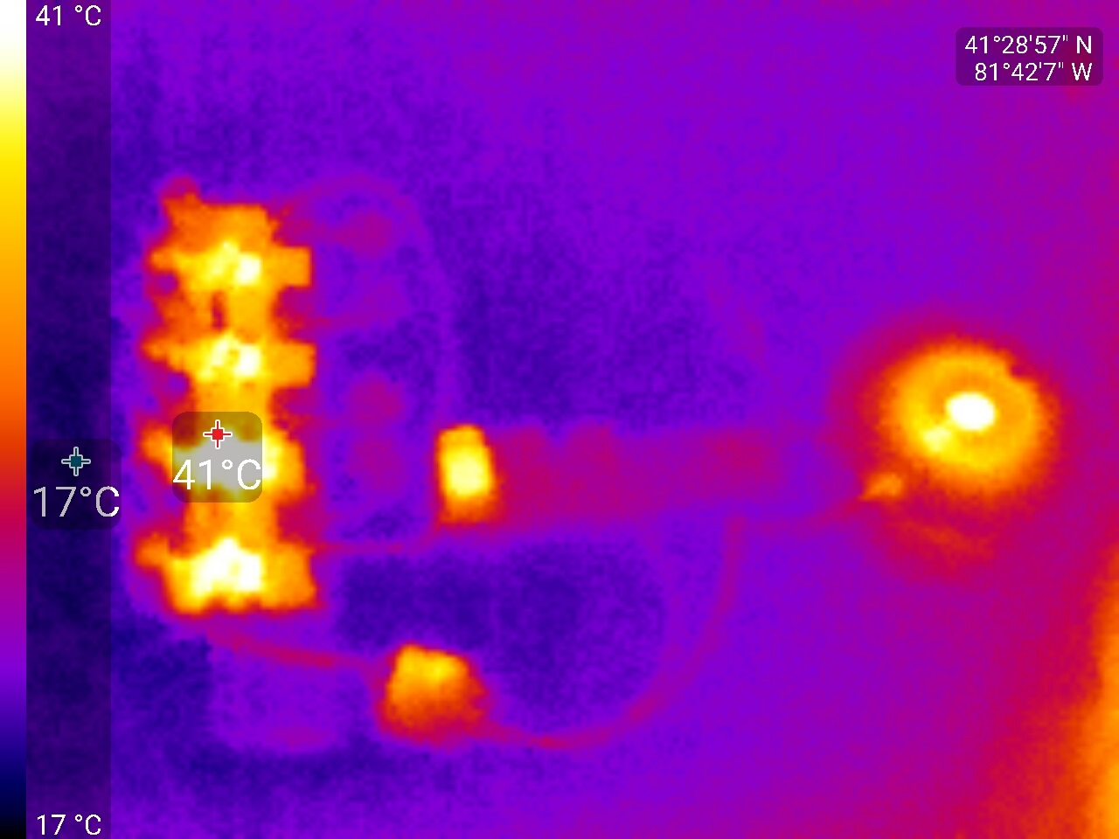
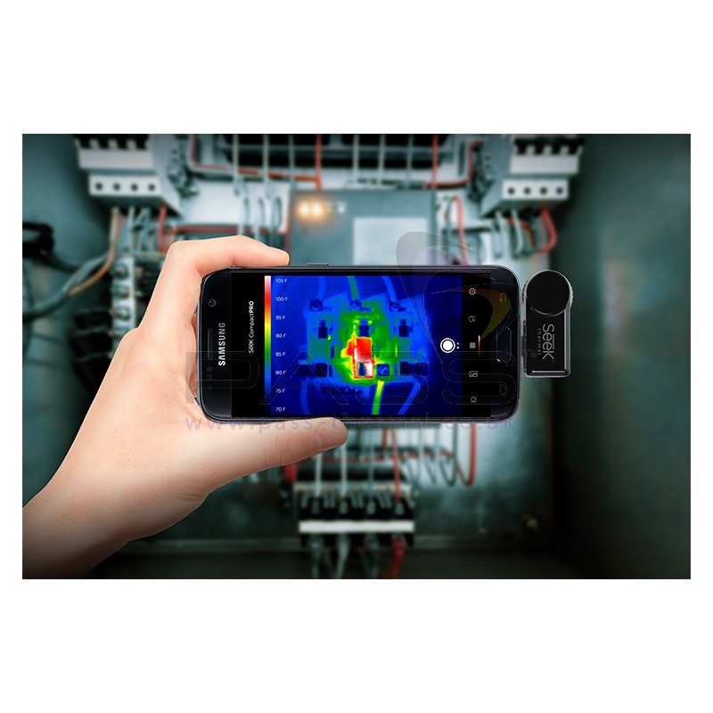
Thermal management
Thermal imaging is extremely useful
Low cost option: Seek thermal compact
Smartphone addon: USD $250
Set I_{L}=6A
No forced convection
Notes:
25s
The final tool I’m going to discuss here is a thermal camera
It’s hard to overstate how useful one of these is, especially for power electronics
***I use the seek compact thermal camera, shown here
***Which can be used with most smartphones, making it fairly cheap
***Here we show heat from our power stage
***With the output current set to 6 amps DC
***The camera immediately what parts are heating up, and how much

Slide 49
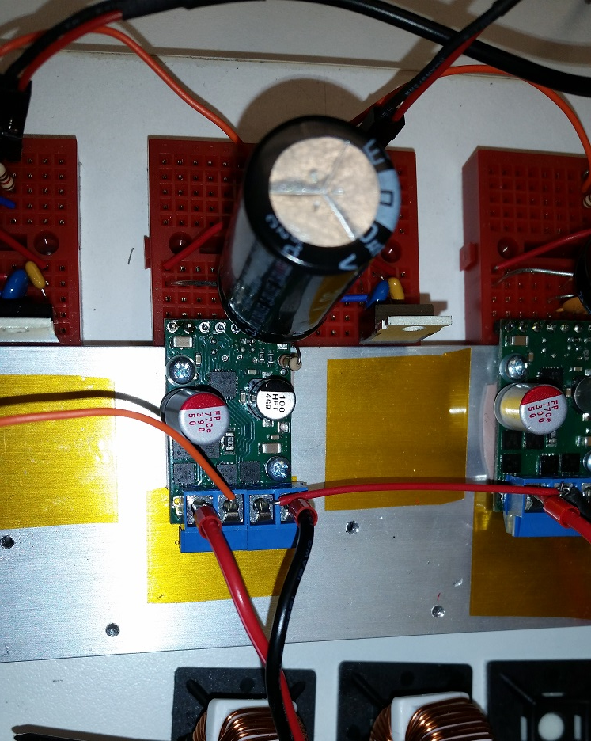
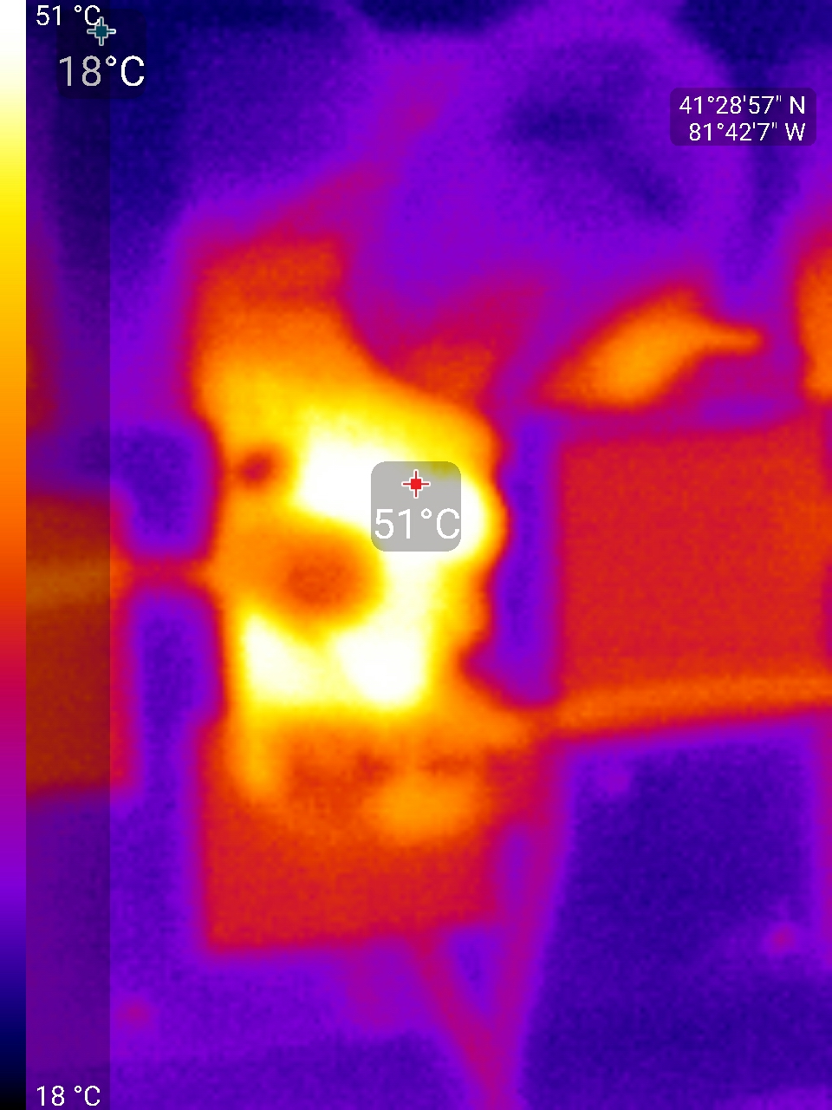
Thermal management
On H-bridges:
Hot spot is on the DC bus capacitor!
Capacitor ESR >> MOSFET R_{DS(on)}
DC bus capacitor
MOSFETs
Notes:
20s
Here we take a closer look at one of the H bridges
***It turns out the hottest spot is not on the
***MOSFETs, shown here,
***But on this DC bus capacitor
***Because its ESR is much higher than the MOSFETs resistance
So that capacitor ought to be replaced

Slide 50
Wrap up
Design tested up to 100V, 20A peak, 20kHz bandwidth
Online repository: https://github.com/mtwieg/Maker-Gradient-Amplifier
Full schematics
Bill of materials
LTspice simulation files
BOM < USD $400
Notes:
20s
So to summarize, we’ve demonstrated a prototype GPA with these specifications
The online repository contains detailed design documents, as well as SPICE simulations
And the overall bill of materials is very low,
Making it accessible to novices

Slide 51
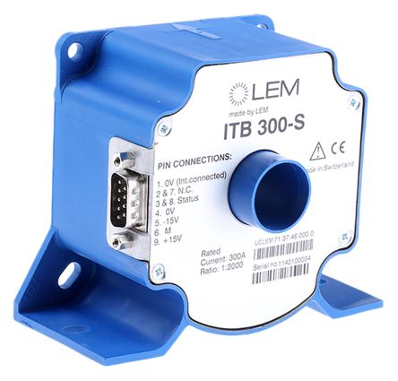


Improvements to be made
Lower drift/noise current sensor
Improve output filter
Digital control
Predistortion
Optimized PWM¹
¹Sabate, J. A. et al. Magnetic Resonance Imaging Power: High-Performance MVA Gradient Drivers. IEEE JESTPE, 2016.
Notes:
20s
Of course there are numerous improvements we should consider
If we want to actually want to use it for imaging
***For example we should add a better current sensor
***And a better output ripple filter
***We should also consider a digital controller
***In order to implement predistortion
***As well as optimized PWM methods

Slide 52
Increasing power
Need AC-DC front end
Multi-output DC-DC
Very low isolation capacitance
Off-the-shelf PSUs aren’t suitable
Custom resonant converters^{1,2}
V_{DD}
V_{DD}
V_{DD}
V_{DD}
¹Sabate, J et al. Resonant power supply for magnetic resonance imaging gradient drivers. PESC 2003
²Pengcheng Z et al. Multi-output power supply with series voltage compensation capability for Magnetic Resonance Imaging system. IPEMC 2009.
Notes:
25s
If we want to increase power,
***one of our bigger challenges is going to be the DC power supplies
***In addition to a high power active front end
***We will need multiple DC outputs
***With very low isolation capacitance
****And to my knowledge, no off the shelf power supplies meet these requirements
***Which means you’ll likely have to develop a custom solution
Probably based on a resonant topology

Slide 53

Thank you!

